Slide 1
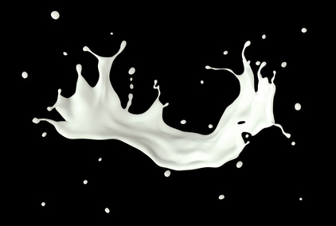
Donor milk: Science and Clinical insights
AWHONN Wisconsin Conference
November 14, 2023
AWHONN Wisconsin Conference
November 14, 2023
Lisa Brock, BSN, RN, IBCLC
Summer Kelly, MS, RN, IBCLC

Slide 2
disclosures
Lisa and Summer have no commercial interests to disclose
Affiliations
Lisa works at Bellin Health
Summer works at Mothers’ Milk Bank of the Western Great Lakes

Slide 3
Objectives
Identify at least one human milk prebiotic that shapes the infant microbiome
List two human milk bioactive factors that are retained after pasteurization
List two indications for donor milk use in the immediate postpartum period

Slide 4
FLYING HIGH AT WISCONSIN AWHONN 2023!

Slide 5
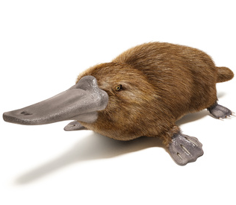
Mammalian Evolution
Monotremes
Marsupials
Placentals

Slide 6
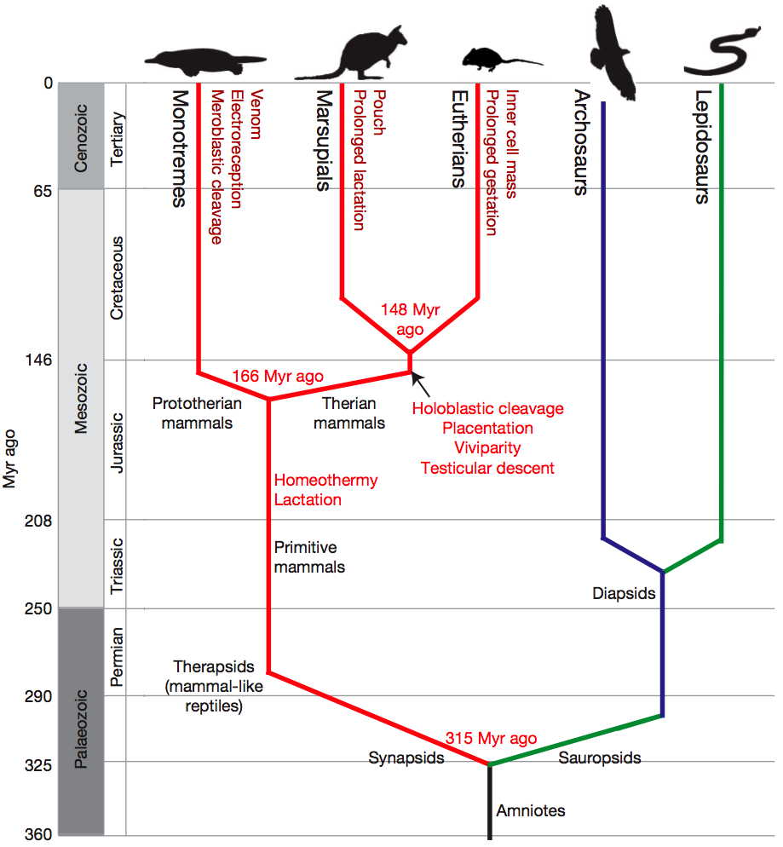
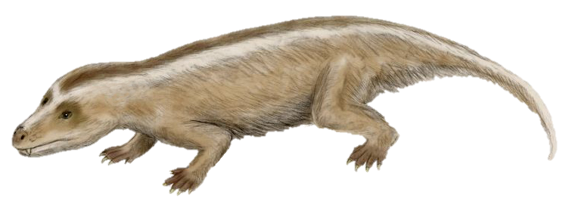
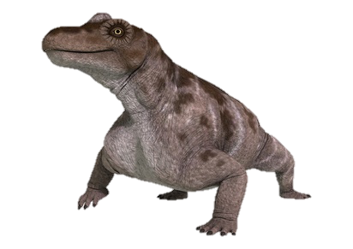
Warren et al.
(2008)
Warren et al. (2008)

Slide 7
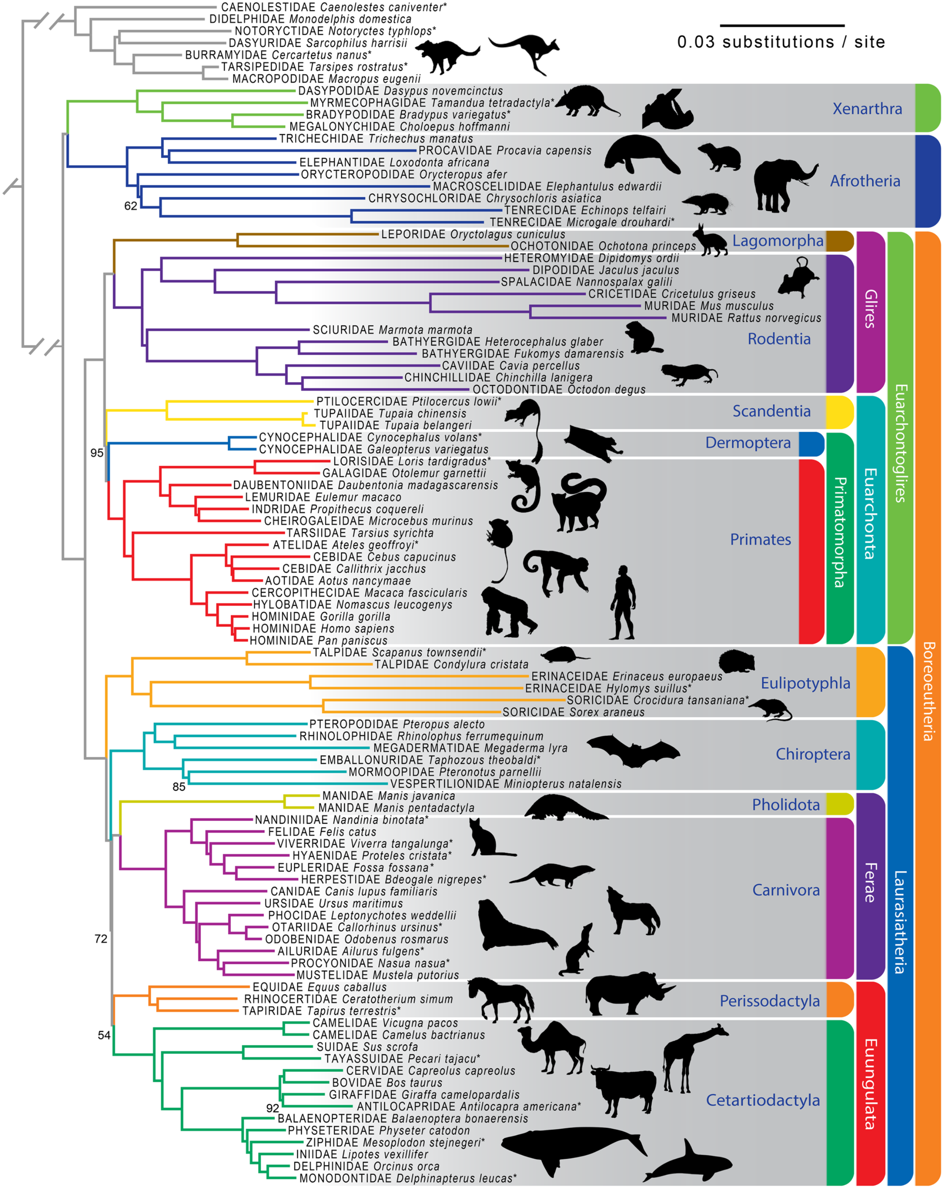
Humans
Bats
Cows
Whales
Esselstyn et al. (2017)
From: Investigating Difficult Nodes in the Placental Mammal Tree with Expanded Taxon Sampling and Thousands of Ultraconserved Elements; Genome Biol Evol. 2017;9(9):2308-2321. doi:10.1093/gbe/evx168
Genome Biol Evol | © The Author 2017. Published by Oxford University Press on behalf of the Society for Molecular Biology and Evolution.This is an Open Access article distributed under the terms of the Creative Commons Attribution Non-Commercial License (http://creativecommons.org/licenses/by-nc/4.0/).
Notes:
Fig. 1. —Maximum likelihood estimate of mammalian phylogeny from 3,787 concatenated ultraconserved elements. Clades discussed in the text are labeled. Branches between Metatheria (marsupials), Eutheria (placentals), and Prototheria (platypus; not shown) were truncated for ease of presentation. Bootstrap support values are 100 unless otherwise noted. Taxa with an asterisk after the specific epithet are those we enriched and sequenced.
7

Slide 8
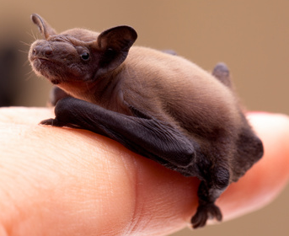
Bats
Bat pups may reach about 70% of maternal weight before they are weaned.
Strong bones and muscles are required to deal with forces of flight (torque, pressure, and wind resistance).
Pipistrellus Bat
Oftedal, 2012

Slide 9
Blue Whale
Blue whales can produce about 220 kg of milk/day (Oftedal, 2012)
Image: InSapphoWeTrust, 2012

Slide 10
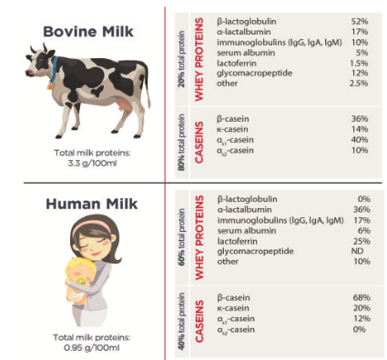
α-Lactalbumin | 17%
Antibodies (IgG, IgA, IgM) | 10%
Lactoferrin | 1.5%
α-Lactalbumin | 36%
Antibodies (IgG, IgA, IgM) | 17%
Lactoferrin | 25%
Layman et al. (2018)
CC BY-NC-ND 4.0: https://creativecommons.org/licenses/by-nc-nd/4.0/

Slide 11
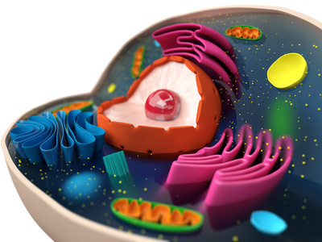

Slide 12
Macromolecules of life
Monomer | Macromolecule
Fatty Acid | Lipid
Monosaccharide | Carbohydrate
Amino Acid | Protein
Nucleic Acid | DNA and RNA
Macronutrients

Slide 13
Human milk Macromolecules
Monomer | Macromolecule
Fatty Acid | Lipid
Monosaccharide | Carbohydrate
Amino Acid | Protein
Nucleic Acid | DNA and RNA
Human milk oligosaccharide (HMO)
Secretory Immunoglobulin A (sIgA)

Slide 14
Carbohydrates
Glucose
Galactose
Lactose
Lactose
Fucose
Human Milk
Oligosaccharide

Slide 15
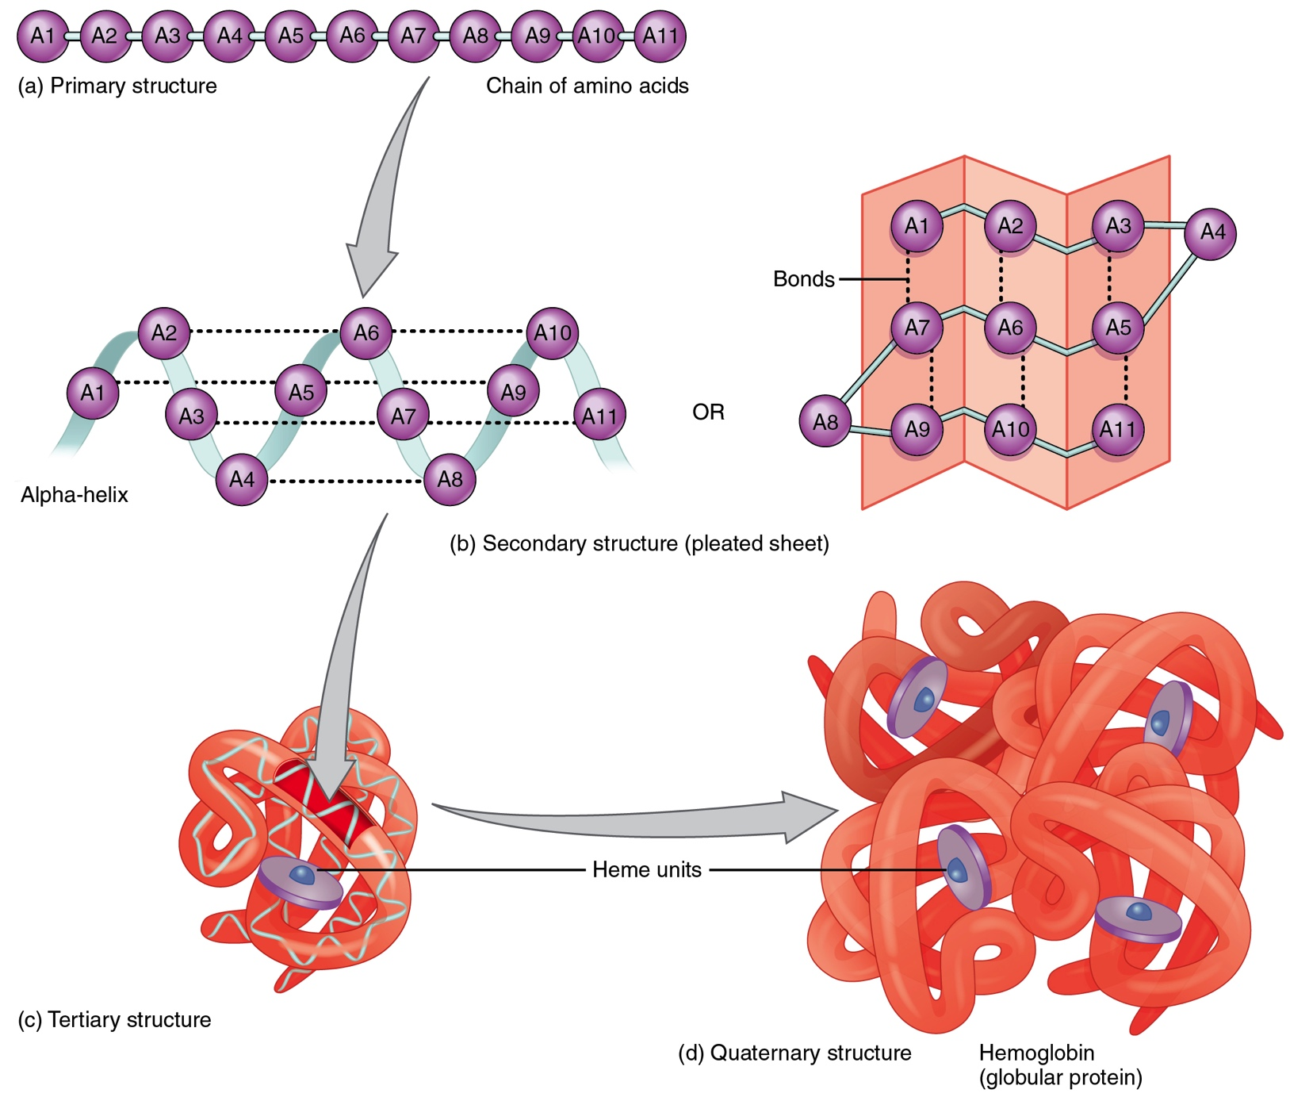
Proteins
By OpenStax College [CC BY 3.0 (https://creativecommons.org/licenses/by/3.0)], via Wikimedia Commons

Slide 16
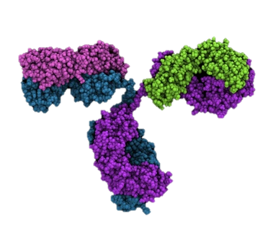
Antibodies recognize antigens
Antibody: protein binds to antigen
Antigen: foreign particle that is recognized by immune system (e.g. bacteria, virus, pollen)
Variable Region
(Antigen Binding Site)
Constant
Region

Slide 17
Antibody Classes
IgG
Major Ab in blood (75%)
Crosses placenta
IgD
B Cell receptors
IgE
Bind parasites
Allergies
sIgA
Major Ab in milk (90%)
Mucosal immunity
IgM
First responder to infection

Slide 18
Secretory Immunoglobulin A (sIgA)
Dominant antibody in human milk
Secretory component protects sIgA from digestion - remains active in infant’s microbiome
Dimeric IgA

Slide 19
Secretory Immunoglobulin A (sIgA)
J-Chain
Dimeric IgA

Slide 20
Secretory Immunoglobulin A (sIgA)
J-Chain
sIgA
Secretory
Component

Slide 21
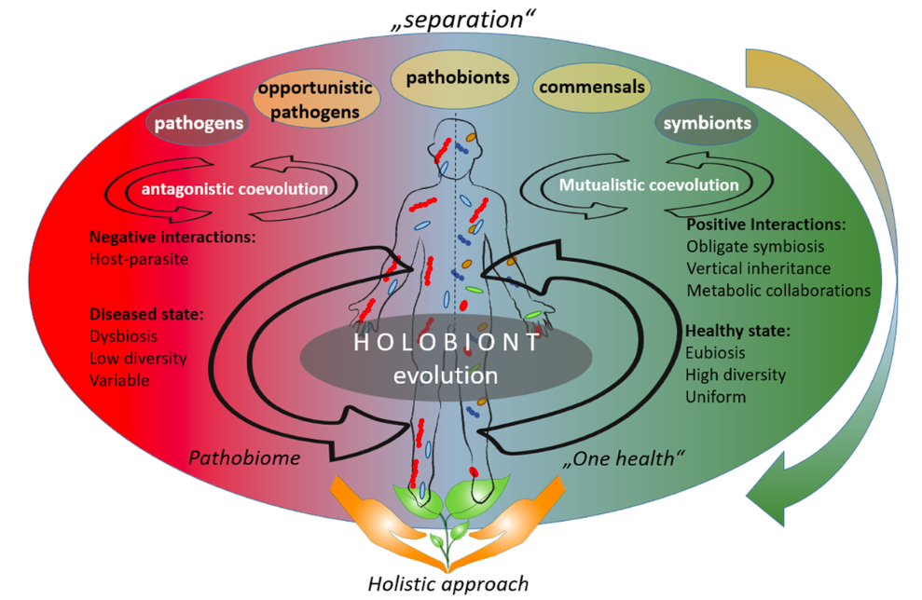
Microbiome definition
Berg et al. (2020)
https://creativecommons.org/licenses/by/4.0/
Original definition: Whipps J, Lewis K, Cooke R. (1988). Mycoparasitism and plant disease control. In: Burge M, editor. Fungi Biol Control Syst. Manchester University Press.
Modified definition: Berg et al. (2020). Microbiome definition revisited: Old concepts and new challenges. Microbiome, 8, 103. https://doi.org/10.1186/s40168-020-00875-0

Slide 22
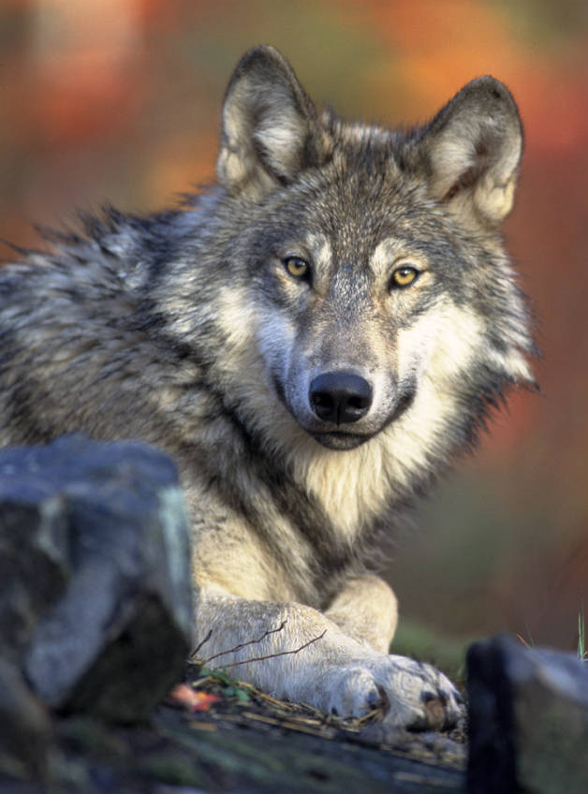
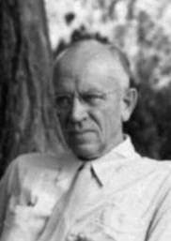
Ecosystem homeostasis
“A thing is right when it tends to preserve the integrity, stability, and beauty of the biotic community. It is wrong when it tends otherwise.” Aldo Leopold
Aldo Leopold
1887-1948
University of Wisconsin
Gray Wolf:
Keystone Species
“Gray Wolf” Gary Kramer, USFWS
https://digitalmedia.fws.gov/digital/collection/natdiglib/id/203
By Howard Zahniser - NCTC Archives/Museum, Public Domain, https://commons.wikimedia.org/w/index.php?curid=71981919
Credit: National Park Service Heinrich Berann Panorama of Yellowstone https://www.nps.gov/carto/app/#!/maps/categories/12

Slide 23
Ecosystem homeostasis
Gray Wolf:
Keystone Species
Yellowstone Wolf reintroduction
Elk & coyote control
Tree growth
Birds returned
Beavers returned- reshaped rivers
“Gray Wolf” Gary Kramer, USFWS
https://digitalmedia.fws.gov/digital/collection/natdiglib/id/203
Credit: National Park Service Heinrich Berann Panorama of Yellowstone https://www.nps.gov/carto/app/#!/maps/categories/12
VIDEO: https://www.yellowstonepark.com/things-to-do/wolf-reintroduction-changes-ecosystem

Slide 24
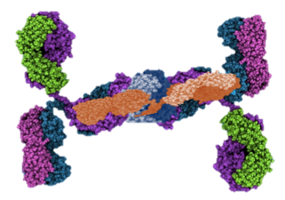
THE
HUMAN MICROBIOME
EXPERIENCE
sIgA antibody
Protein
HMO
Carbohydrate

Slide 25
THE
HUMAN MICROBIOME
EXPERIENCE
sIgA antibody
Protein
HMO
Carbohydrate
Escherichia coli
Bifidobacterium longum

Slide 26
Human milk microbiome
Biotic factors
Microbial communities
Abiotic factors
pH, temperature, fluid dynamics
Macronutrients & micronutrients
Bioactive factors
sIga protein
HMO carbohydrates
Clinical factors that impact microbiome
Breast dysbiosis, mastitis
Maternal antibiotics, other meds
Edema, engorgement
Maternal diet
Source: US Breastfeeding Committee
Ruiz et al., 2019; Demmelmair et al., 2020

Slide 27
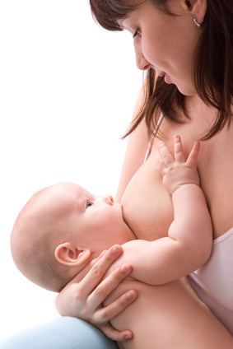
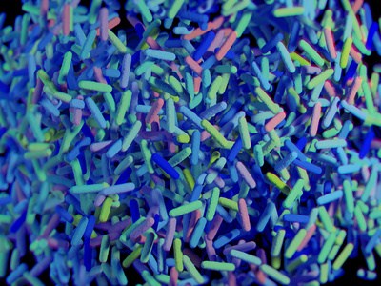
ECOSYSTEM HOMEOSTASIS
Retrograde flow from baby to breast may contain signals that impact milk microbiome
Mom’s milk shapes infant’s microbiome
Microbiota
HMOs to nourish microbiota
sIgA to promote homeostasis

Slide 28
Milk Oligosaccharide
Human milk
oligosaccharide
Human milk
sIgA
Keystone Species:
Bifidobacterium longum
subs. infantis
E. coli
Abiotic factors: pH, flow, osmolality
Biotic factors
mucus, surface receptors
Infant GI Microbiome

Slide 29
Milk Oligosaccharide
Human milk
oligosaccharide
Human milk
sIgA
Keystone Species:
Bifidobacterium longum
subs. infantis
E. coli
Abiotic factors: pH, flow, osmolality
Biotic factors
Use Community Ecology Theory to Study Human Milk as a Biological System
mucus, surface receptors
Infant GI Microbiome

Slide 30
Milk Oligosaccharide
Neutralization
Competitive Exclusion

Slide 31
Milk Oligosaccharide
sIgA promotes microbiome homeostasis
Pathogenic bacteria
Immune exclusion via agglutination & enchaining
Prevent attachment via neutralization
Clearance- physical removal from gut
Enchaining may prevent horizontal gene transfer
Probacteria
sIgA carbohydrate motifs as carbon source
Promote adhesion
Gopalakrishna et al., 2019; Hoces et al., 2020; Rogier et al., 2014; Smilowitz et al., 2018

Slide 32
Infant GI Microbiome
Milk Oligosaccharide
Human milk
oligosaccharide
Human milk
sIgA
Keystone Species:
Bifidobacterium longum
subs. infantis
E. coli
Richness: Number of bacterial species
Relative Abundance: Ratio of one species
Diversity: Richness and relative abundance
Breastfed Infant’s Microbiome

Slide 33
Infant GI Microbiome
Milk Oligosaccharide
Human milk
oligosaccharide
Human milk
sIgA
Keystone Species:
Bifidobacterium longum
subs. infantis
E. coli
Formula Fed Infant’s Microbiome

Slide 34
Bioactive factors
Human milk factors | 1. Mom’s Milk | 2. Donor Milk | 3. Formula
Immuno-reactive cells | 100% | 0% | 0%
sIgA antibody | 100% | 70% | 0%
Lactoferrin | 100% | 40% (10-65%) | 0%
Lysozyme | 100% | 75% (30-80%) | 0%
Cytokines | 100% | Many are retained | 0%
Growth Factors | 100% | 60-100% | 0%
Oligosaccharides | 100% 200+ types 12-21 g/L | 100% 200+ types 12-21 g/L | 2-3 types synthetic 0.6-1.2 g/L
Gangliosides | 100% | 100% | 0%
Lipids | 100% | 100% | *Not comparable
Data from Tully et al., 2001; Riskin, 2020; Peila et al., 2016

Slide 35
Nutrition shapes the microbiome
Human milk factors | Mom’s Milk | Pasteurized Donor Milk* | Formula
Microbiota | Mom shares unique microbiota | No microbiota (can add probiotics) | Some contain probiotics (usually 1 strain)
HMOs | Unique to mom 200+ types (12-21 g/L) | 100% retention of donors’ HMOs 200+ types | 2-3 synthetic types Low concentration (0.6 – 1.2 g/L)
Non-digestible carbohydrates (GOS, FOS) | 0 | 0 | Some contain GOS or FOS or mix
sIgA Antibody | Unique profile reflects mom’s life history | 70% retention of donors’ sIgA | 0%
pH, osmolality, fatty acids, growth factors | Shaped by evolution & shared by mom to shape her baby’s microbiome | Human milk shared by many mom is gently heat processed | Very different, many factors lacking
*Only applies to milk that is Holder pasteurized. Significant loss of sIgA occurs when milk is retort processed to create a shelf stable product (Lima et al, 2017; Meredith-Dennis et al., 2017)

Slide 36
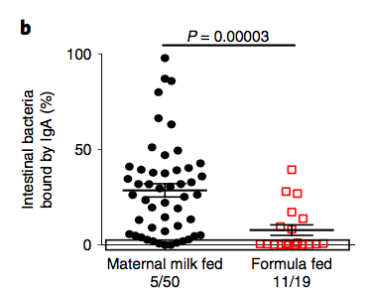
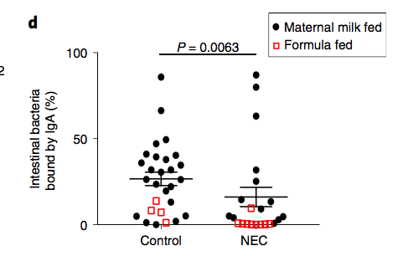
Human milk IgA may protect against NEC
Intestinal bacteria bound to IgA antibody (%) was positively correlated with human milk feedings (Figure b) and negatively correlated with NEC (Figure d).
Gopalakrishna et al. (2019). Nat Med, 25, 1110-1115.
https://doi.org/10.1038/s41591-019-0480-9

Slide 37
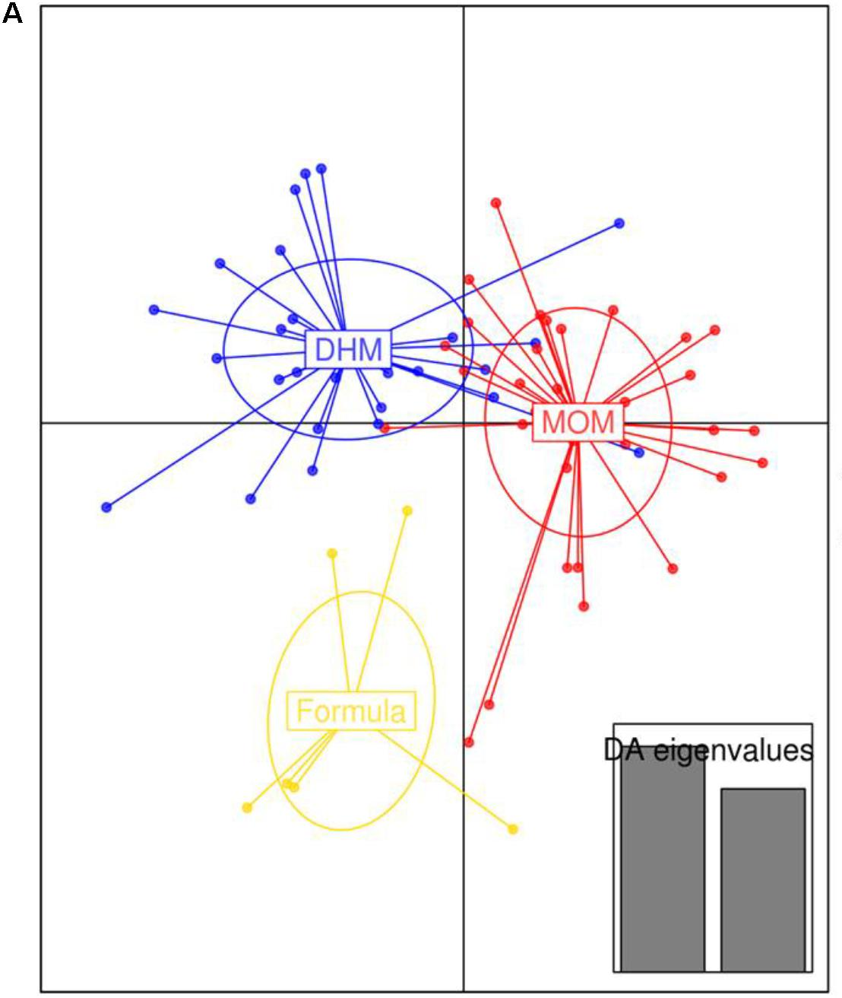
Nutrition shapes infant microbiome
Discriminant analysis of principal components (DAPC) plot at OTUs level revealed distinct clustering of the MOM, DHM, and formula-fed group.
Copyright © 2018 Parra-Llorca, Gormaz, Alcántara, Cernada, Nuñez-Ramiro, Vento and Collado. https://creativecommons.org/licenses/by/4.0/

Slide 38
Nutrition shapes infant microbiome
Discriminant analysis of principal components (DAPC) at KEGG pathways.
Functional activities
Metabolism
Cell signaling
Immune programming
Copyright © 2018 Parra-Llorca, Gormaz, Alcántara, Cernada, Nuñez-Ramiro, Vento and Collado. https://creativecommons.org/licenses/by/4.0/

Slide 39
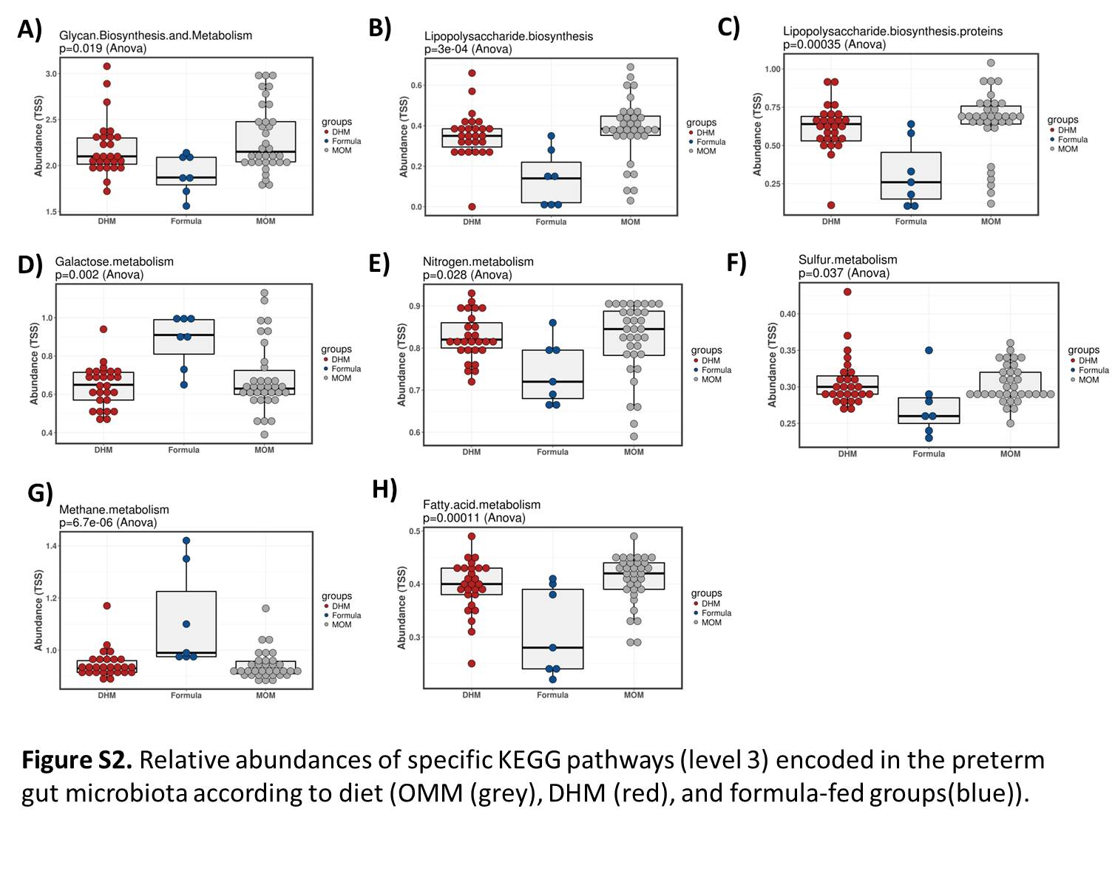
Copyright © 2018 Parra-Llorca, Gormaz, Alcántara, Cernada, Nuñez-Ramiro, Vento and Collado. https://creativecommons.org/licenses/by/4.0/

Slide 40
Donor Milk on the Mother Baby Unit
Human milk contains essential bioactive factors that promote immune development and a healthy microbiome
Offer parents increased feeding choices
Donor milk availability associated with higher breastfeeding rates at discharge (Belfort et al., 2018)
Newborns who were supplemented with donor milk, instead of formula, were five times more likely to be exclusively breastfed at 6 months of age (Merjaneh et al., 2021)
Supplementation on Mother Baby Unit | Exclusive Breastfeeding at Discharge
Donor milk or formula | 77%
Formula only | 56%
Data from Belfort et al., 2018
Notes:
Even just having donor milk as an option increased breastfeeding rates at discharge

Slide 41
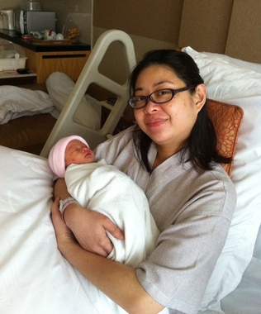
Donor milk on mother baby unit
Indications (Sen et al., 2018)
Weight loss/dehydration
Poor latch
Low supply
Physician request
Parent request
Multiples
SGA/IUGR
Hypoglycemia
Jaundice
Breast anomaly/surgical history
Mother/infant separation
Notes:
Keep or delete?

Slide 42
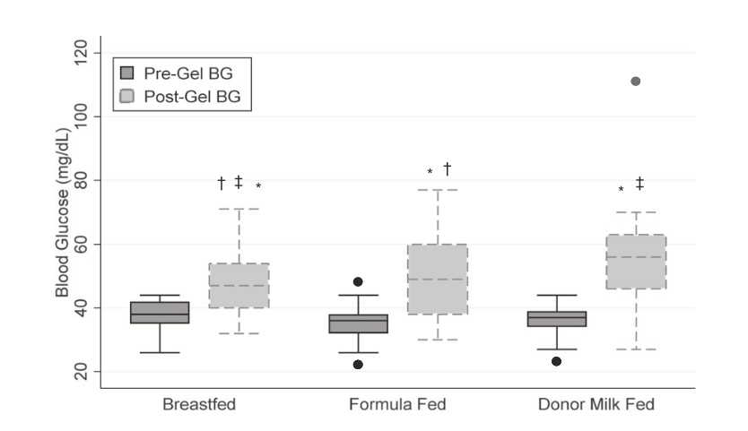
Donor milk for hypoglycemia
Pre and post gel blood glucose (BG) in 99 infants >35 weeks gestation being treated for hypoglycemia. There are 33 infants in each group.
Sen et al. (2020). Journal of Perinatology (2020) 40:1705–1711 https://doi.org/10.1038/s41372-020-00776-y

Slide 43
Donor milk for hypoglycemia
“The magnitude of rise in BG with formula and gel is similar to that observed with donor milk and gel, suggesting that both combinations are equally effective in raising blood glucose concentrations.”
Entire cohort (99 babies >35 weeks) | Formula | Donor Milk
Pre-gel BG(mg/dl)➔ Post-gel BG mg/dl (increase) | 36 ➔ 49 (17 mg/dl increase) | 37 ➔ 56 (19 increase)
Late Preterm subgroup | Formula | Donor Milk
Pre-gel BG(mg/dl)➔ Post-gel BG mg/dl (increase) | 35 ➔ 49 (16 mg/dl increase) | 37.5 ➔ 59 (19.5 increase)
Term subgroup | Formula | Donor Milk
Pre-gel BG(mg/dl)➔ Post-gel BG mg/dl (increase) | 36 ➔ 54.5 (18.5 mg/dl increase) | 37 ➔ 52 (15 increase)
Sen et al. (2020). Journal of Perinatology (2020) 40:1705–1711 https://doi.org/10.1038/s41372-020-00776-y

Slide 44
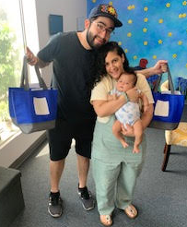
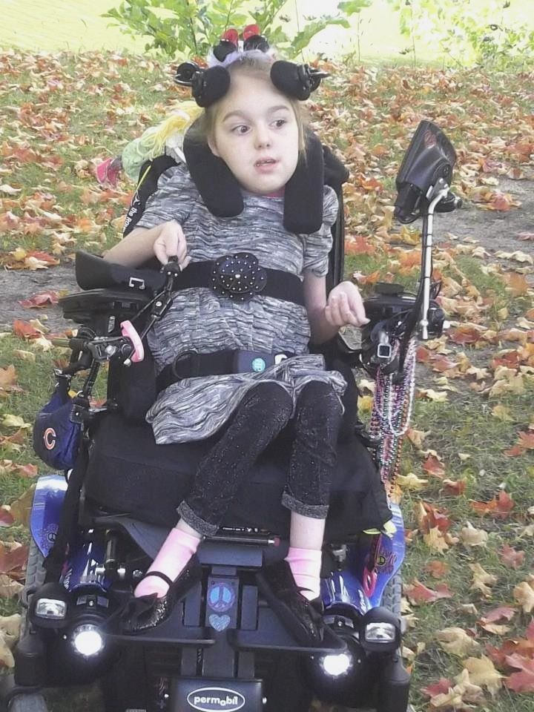
Outpatient Indications
NICU graduate
Congenital disorders
sIgA deficiency
Formula intolerance
GI diagnoses
Failure to thrive
Spinal muscular
atrophy (SMA)
Palliative care &
maternal death
Human baby

Slide 45
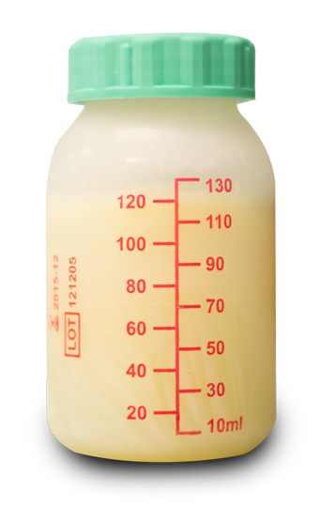
Outpatient Accessibility
Milk Bank Charity Care
Insurance Coverage
Not mandated in Wisconsin
Private insurance may cover
Insurance consults available pending patient diagnosis
Advocacy efforts are growing!
Family income / size
Patient medical need
Availability of maternal milk
Maternal health
Donor milk supply
Donor milk demand
WALC grants

Slide 46
Milk Dispensaries
Milk distribution sites:
Dispense milk with provider prescription
Ideal for short-term supplementation
Increased access and ease
Increased feeding choices
Locations:
Pharmacies
Hospitals
Clinics
Notes:
And growing!!

Slide 47
Milk Donors Needed!
Help us save tiny lives in Wisconsin & Illinois by sharing education about milk donation!
Apply Here!
https://www.milkbankwgl.org/donate-milk/
Patient education
Milk storage magnets
Bilingual screening services
Increased depot options
Expanded courier service
Bereavement services

Slide 48
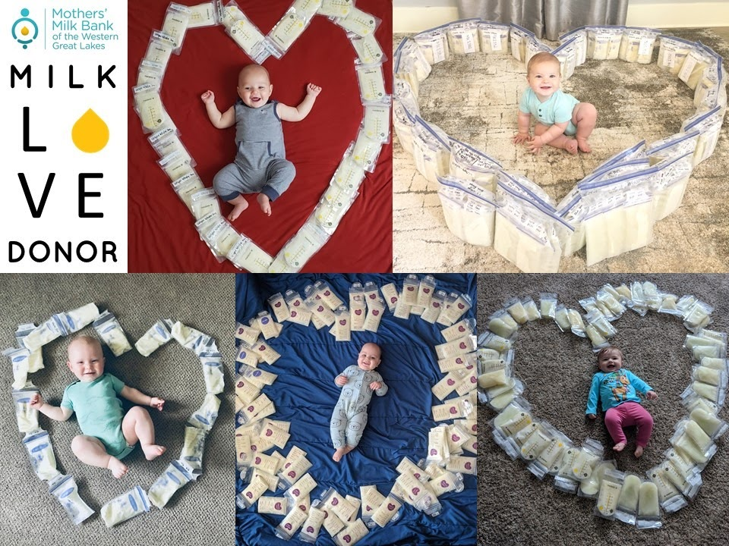
Notes:
None of this would be possible without our amazing donors!!

Slide 49
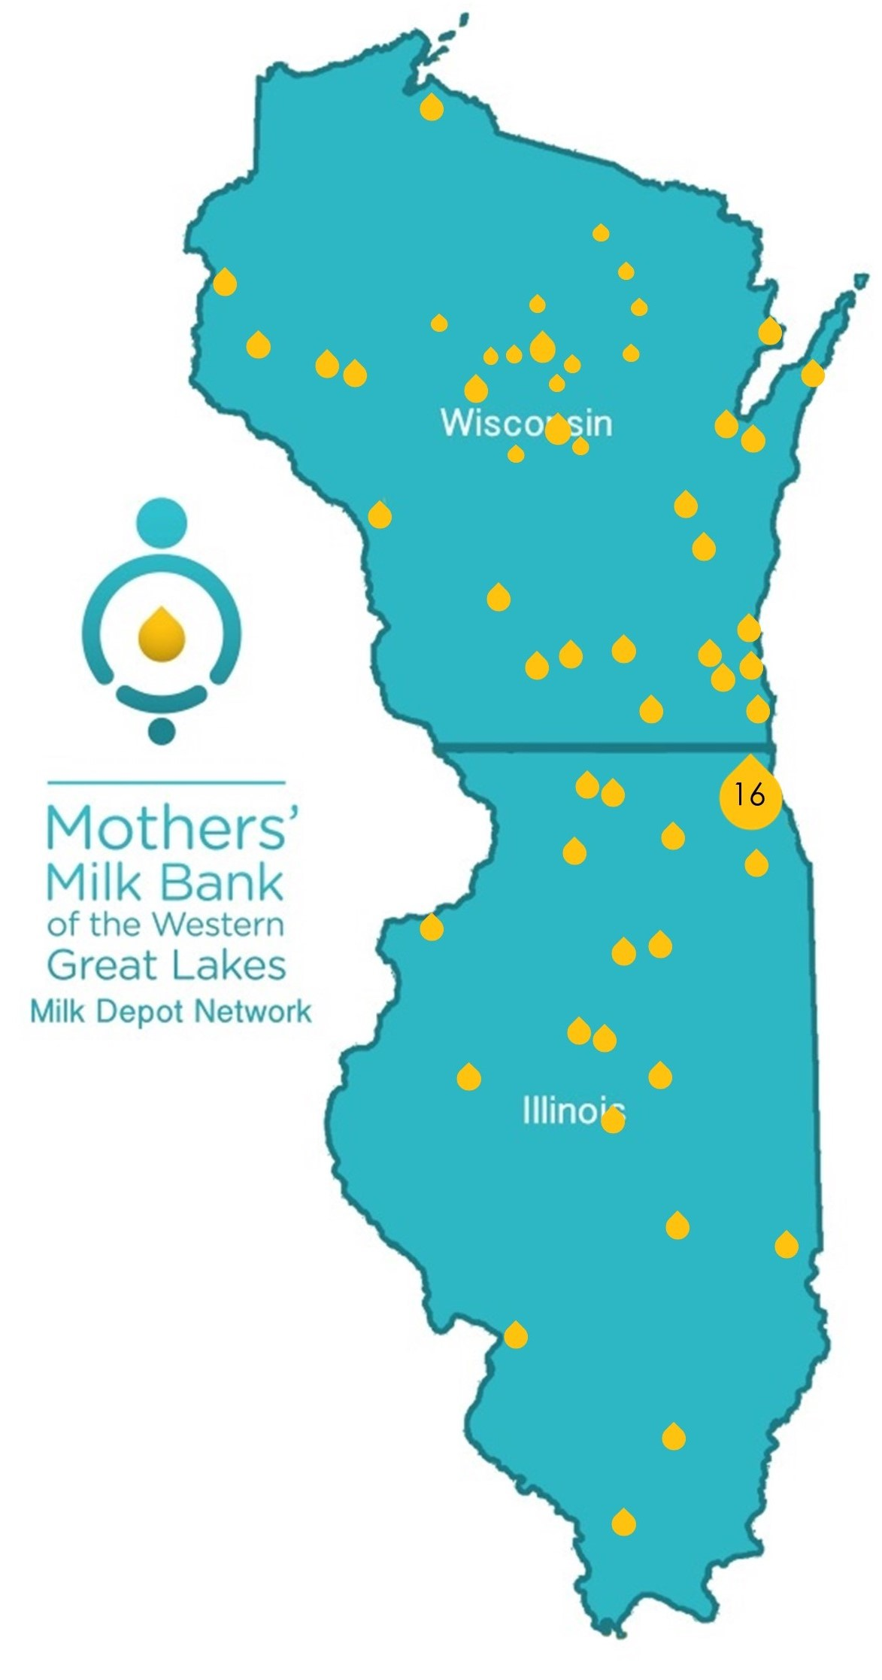
Milk Depots
Milk Collection Sites:
Accept milk
Store milk in freezer
Assist with milk transport to milk bank
Locations:
WIC clinics
Public health departments
Hospitals
Doctor’s offices
Pharmacies
Lactation clinics
Notes:
Banner updated but not map

Slide 50
Bereavement Milk Donation
Poppy’s Dream Memorial
More than Milk

Slide 51
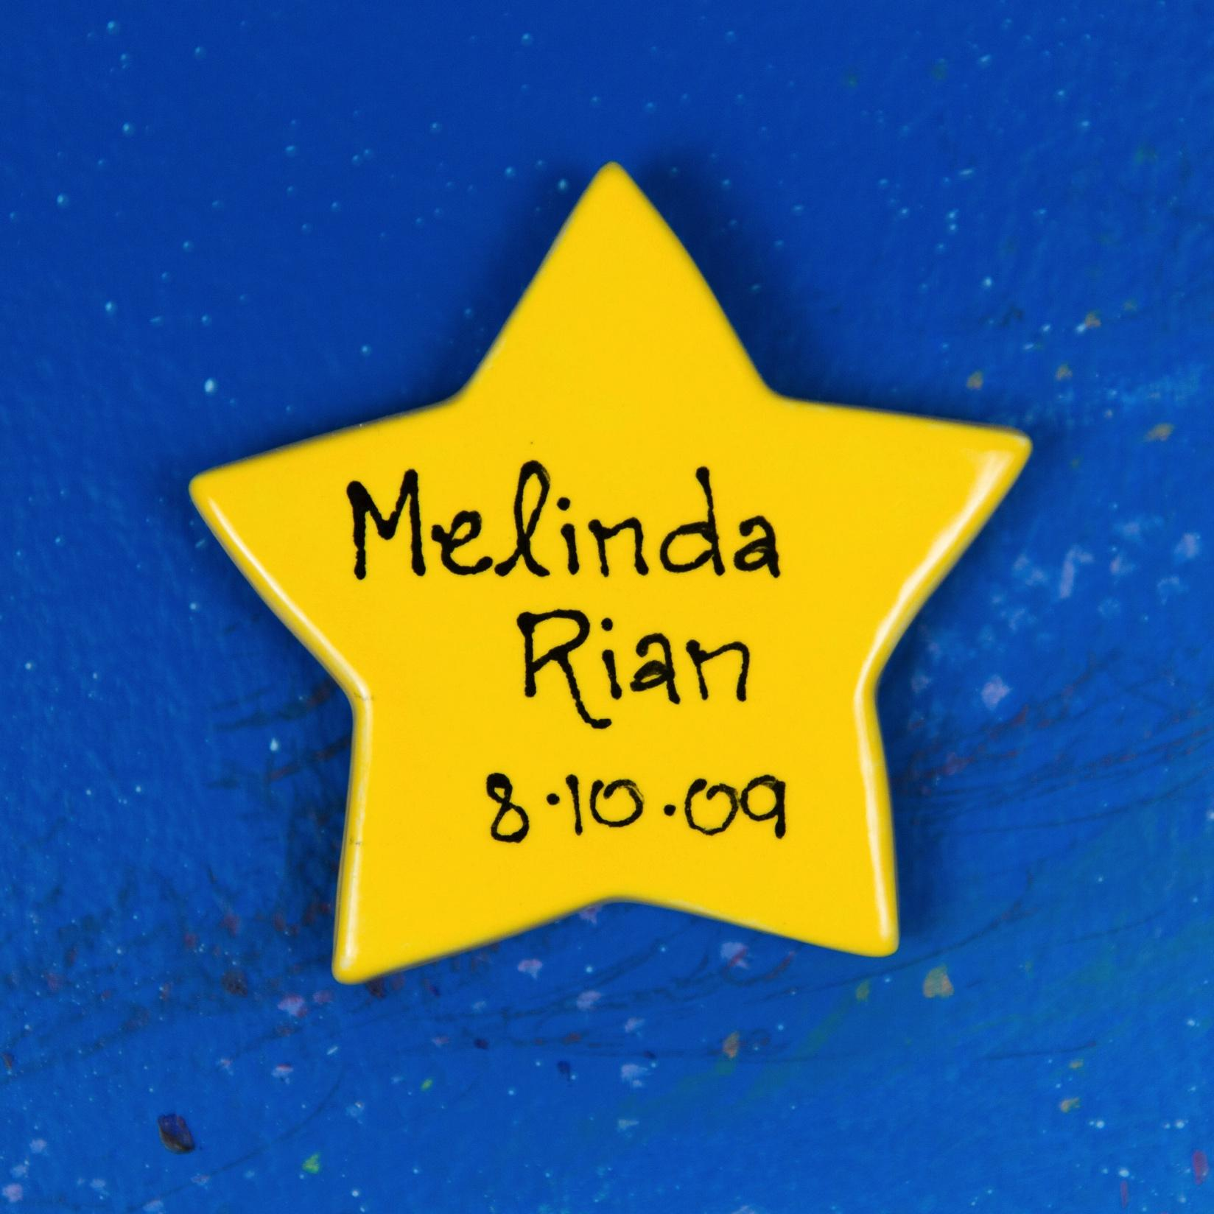
Bereavement donation Themes
Grieving the loss of motherhood
Pumping maintained connection to baby
Pumping out of necessity
Pumping as a tool for grieving loss
Determination not to throw milk away
Difficulty letting go of the milk
Giving meaning to the experience
Healing from loss
Relief in learning about option to donate milk
Support (or lack of) from nurses and lactation consultants
Importance of addressing lactation with bereaved mothers
Welborn (2012)
Notes:
In-depth, semi-structured interview of 21 bereavement milk donors

Slide 52
Adopting a Donor Identity
“At the milk bank, we’re known as ‘Everett’s family’, and that’s something so special and not true anywhere else.”
Kate, Everett’s Mom
Overall, adopting a donor identity allowed mothers to transition from their pre-loss identities (e.g., “mothers to be”) toward their new identity as bereaved mothers. As the findings demonstrate, donating in times of grief was both emotionally and physically healing.
Oreg (2019)
Notes:
Newer research, specifically quotes one of our donors about our program, we are honored to be included

Slide 53
Important considerations
Milk donation is offered as a choice
“Some mothers choose to pump and donate to a milk bank. If you would like more information…”
Some mothers may need time to decide
Keep milk safe in unit freezer
There are no exclusions for bereavement donors- all milk is accepted
Annual candle lighting ceremony and star placement events at milk bank
Milk Bank Education
Bereavement brochures
Bereavement in-services for staff
Notes:
More than Milk

Slide 54
Voices of Mothers who Continue to Express milk after their infant’s death for donation to a milk bank Article QR Code
“Purpose of the study was to explore the experience of women choosing to continue to express milk after perinatal loss specifically for donation to a non-profit milk bank governed by the Human Milk Banking Association of North America (HMBANA). ~Paraszczuk et al., 2022

Slide 55
7 Major themes from Qualitative data analysis
1. An outlet to grieve
2. A meaningful life
3. Still a mother
4. A positive from a negative
5. Support and recognition
6. Letting go and moving on
7. Finding my way
Paraszczuk et al., 2022

Slide 56
An Outlet to Grieve
A powerful connection of milk donation with helping mother’s get through their grief.
Continuing to express and donate their milk helped them have moments of peace and clarity during a very difficult time.
“I would have a picture of my baby in front of me and I’d be pumping ..it was a source of therapy”. Carol
“…it changed my life. I do not know how I would have gotten through this without being able to pump.” Marie
Paraszczuk et al., 2022
Notes:
Giving life to others from my loss
Sharing life saving human milk for another baby

Slide 57
A Meaningful life
Represents how mothers milk donation brought meaning to their child’s life.
Carol “To me , no matter how short a life is here, it changes your world forever. …to donate milk in her honor and in memory of her, it’s her Legacy”.
“One of our child’s last gifts to the world.” Shawna
Rose “It was a Legacy…doing something in her name.. She’s going to make a difference now!”
Paraszczuk et al., 2022

Slide 58
Discussion
Finding are consistent with published literature, with two subgroups that were formed within this study. Allowed for comparison of the experience of those with a previous breastfeeding experience and those who did not have a previous breastfeeding experience. This provides information for Health Care Providers ( HCPs) to understand the experience of bereaved milk donors and serves as a Call to Action to HCPs to develop best practices and incorporate lactation management in enhanced individualized bereavement care.
Paraszczuk et al., 2022
Notes:
What is known on Challenges Moms face:
Themes : Phenomena of Donation
Diminished Grieving
Enhanced connection to infant
Establishment of Legacy
Creation of Positive from a Negative

Slide 59
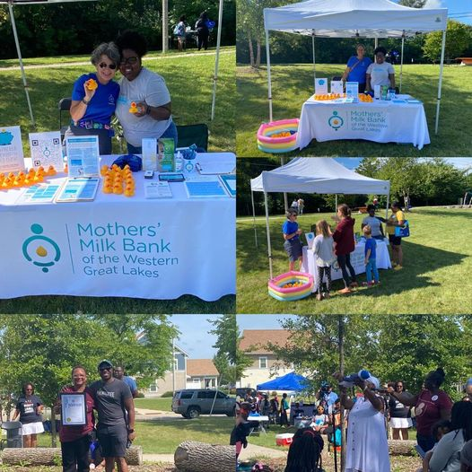
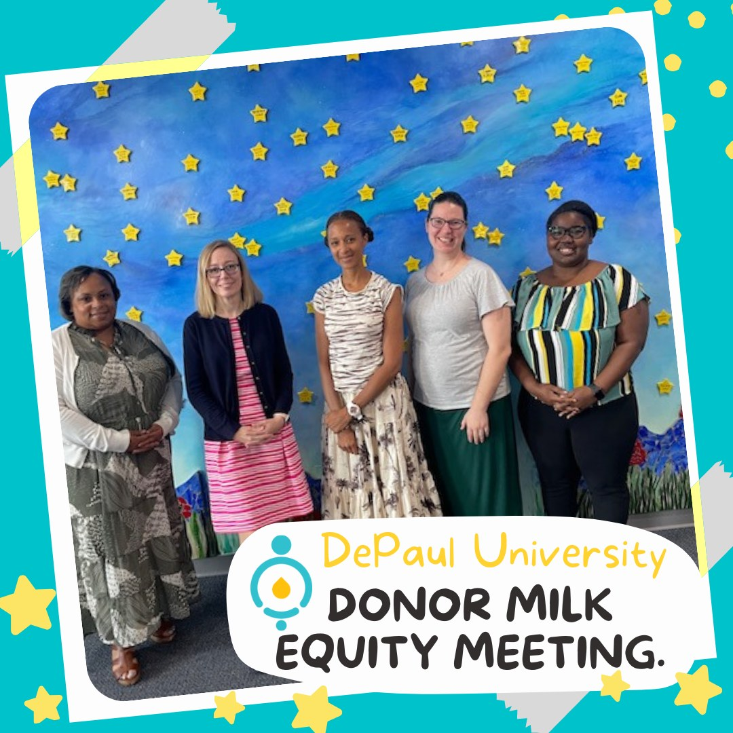
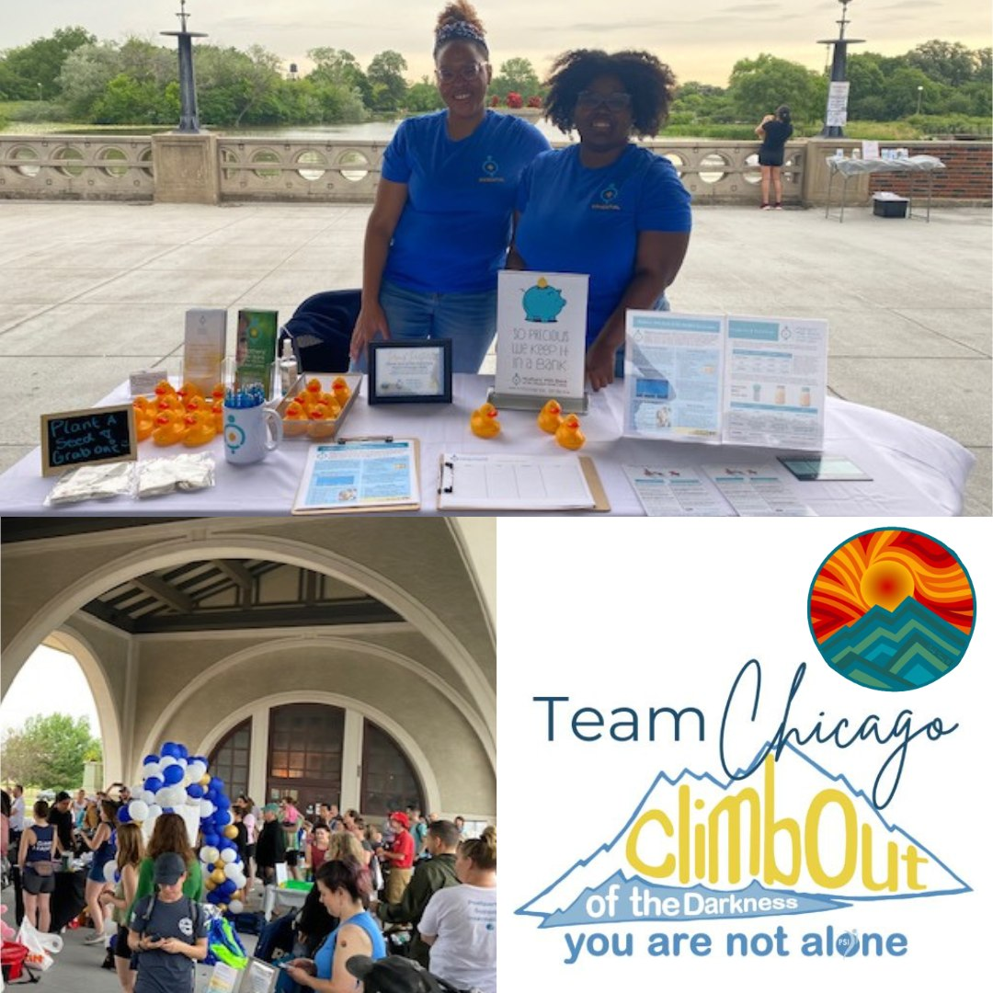
Donor Milk Equity
African American Breastfeeding Network (AABN):
http://aabnetwork.org
https://www.usnews.com/news/healthiest-communities/articles/2020-09-03/breast-milk-bank-on-mission-to-reduce-inequities-for-babies-of-color
DePaul Equity Research
Climb out of the Darkness
AABN Lift Up Every Baby

Slide 60
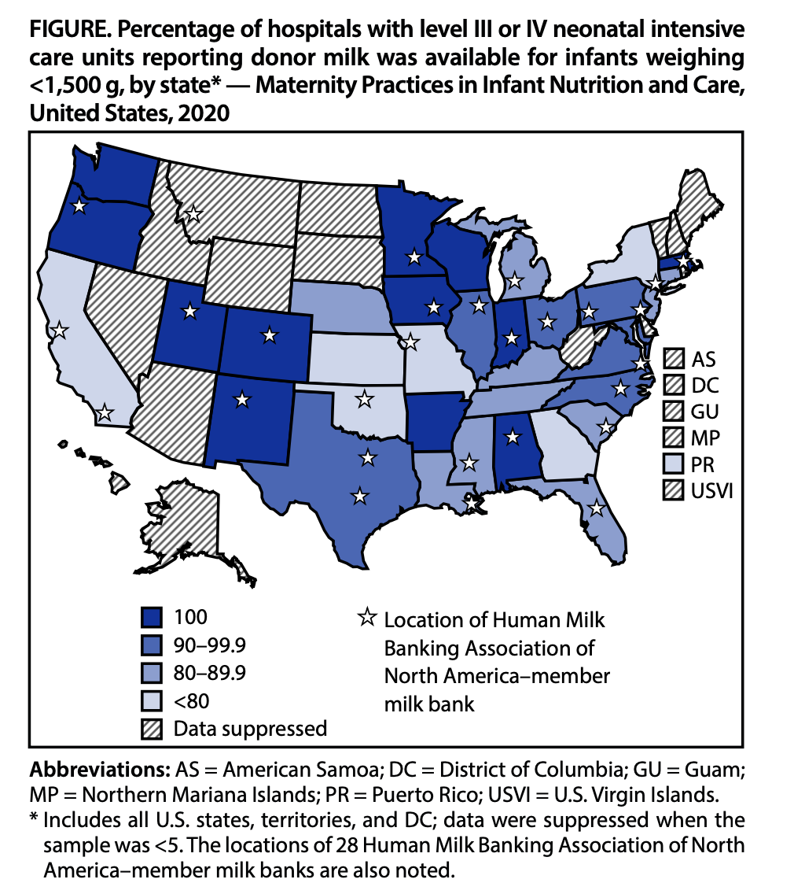
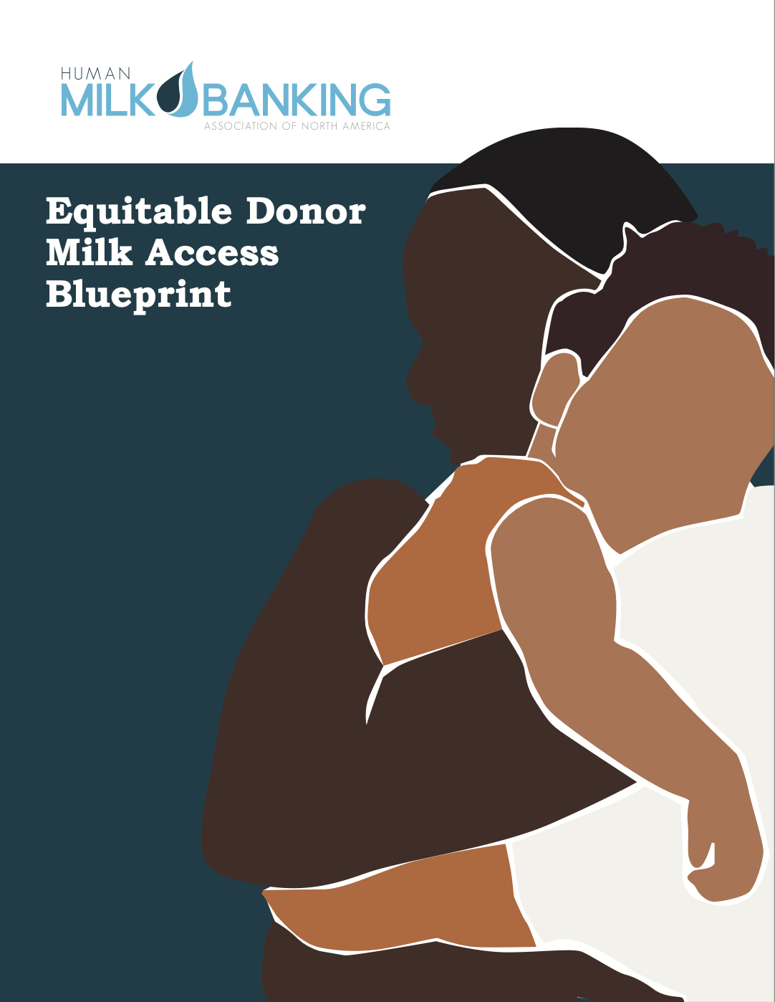
Donor Milk Equity
In the U.S., black babies are less likely to receive donor milk than white babies (Boundy et al., 2017).
Download from HMBANA.org

Slide 61
Wisconsin and Human Milk Feeding
Wisconsin Mpinc score 82% in 2022.
National Mpinc score 81% mothers are breastfeeding in 2022.
CDC, Breastfeeding Report Card 2022.
Notes:
Mpinc is CDC national survey of Maternity Practices in Infant Nutrition and Care.
Human Stem Cells
4 different types of stem cells in breast milk
A non-invasive way to obtain stem cells via breast milk
Bone cells
Fat cells
Liver cells
Brain cells
Mpinc measures care practices and policies that impact newborn feeding, feeding education, staff skills and discharge support.
CDC invites all hospitals with maternity Services to participate. 64 of 86 eligible hospitals participated in 2022.
Your programs are grounded in evidence based practice and tied into our philosophy of family centered care.

Slide 62
HMBANA Accreditation
FSMA, cGMPs, & Food Code
FDA facility registration
FDA inspections
Food safety plan (FSP)
Preventive controls:
Donor screening, blood testing
Pasteurization
Verifications
Sanitation controls
Microbial sampling protocol
PCQI required at each milk bank
HMBANA On-site audits
Trained auditors are PCQI certified and have at least 5 years of milk banking experience
Three-day audit: Pre-work desk audit and two on-site inspection days
Extensive donor and pasteurization record review 60+ records reviewed
SOP, FSP, and calibration review
GMP walkthrough, staff interviews, and observations
Protocol for significant non-compliance includes suspension and FDA notification

Slide 63
Donor Safety: Controlling Biological and Chemical Hazards
“Triple Screen” – 1) health history 2) health care provider statement 3) blood testing for HIV, hep B, hep C, HTLV, & syphilis; all donor charts reviewed by licensed RN
Healthy lifestyle choices – exposure to toxins, including nicotine and alcohol, avoidance of unapproved supplements, and safe partner
Healthy medical status – evaluation of medication use, chronic illness, communicable disease, and health risks
Commitment to initiate and continue communication – ongoing screening every two months
Notes:
Intent – ensure a critical supply of donor milk eliminating potential of harm through lifestyle or medical risk factors

