Slide 1
Critical Care Obstetrics in the Rural Setting: Stabilize, Manage, and Transfer
Suzanne McMurtry Baird, DNP, RN
Stephanie Martin, DO

Slide 2
Objectives
Recognize
Recognize critical illness in pregnancy.
Initiate
Initiate stabilization.
Coordinate
Coordinate timely transfer.
Improve
Improve team response and outcomes.

Slide 3
Case Study
32 yo G4 P0030
31 weeks’ gestation
Arrives at physician’s office
BP 200s/120s
3-minute FHR deceleration
Sent to Level 1 hospital

Slide 4

Case Study: OB Triage
BP 172/108
Treated with 2 doses of hydralazine
BPs improved to 140s/90s
Hct 47%
EFM: recurrent late decelerations and minimal variability
Plan: delivery due to FHR pattern, remote from delivery, and hypertension

Slide 5
Case Study: Delivery
Cesarean delivery under general anesthesia
Abruption noted
I&O in OR
IVF 900 mL
EBL 1000 mL
UOP 65 mL
PACU
BPs 120s-140s/80s
UOP 50 mL
Several episodes of nausea and vomiting
Large amount of vaginal bleeding
Magnesium sulfate at 2 grams/hour

Slide 6
Case Study: Update
BP 71/36 (MAP 48)
HR 110-130s
SpO₂ 94-96% on 2L NC
LOC: groggy
Extremities cold
Foley catheter in place
tea colored urine
4+ proteinuria
Small amount vaginal bleeding
Dressing dry, intact
Plan: Labs and abdominal US

Slide 7
Case Study: Update
Abdominal US: negative for internal bleeding
Labs:
Hemoglobin 7.3; Hematocrit 25%
Plts 78,000
LDH 1771
AST 83
Cr 1.2
INR 1.1
Magnesium level 9.1 mg/dL

Slide 8
Case Study: Update
IVF boluses given
BPs 70-80s/30-40s (MAP 40-50s); improved to 90s/50s (MAP mid 60s)
HR 110-130’s
UOP 4-30 mL/hour
Magnesium sulfate DC’d
LOC: sleepy
Skin pale, cold
Hct now 19%

Slide 9
WHAT'S YOUR
PLAN?

Slide 10
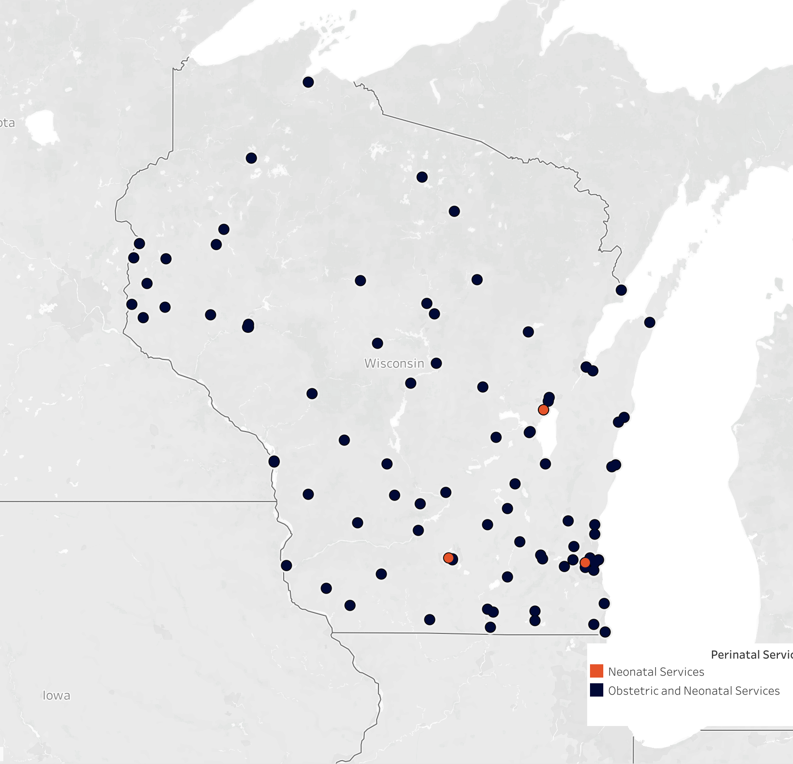
Perinatal Services in Wisconsin

Slide 11

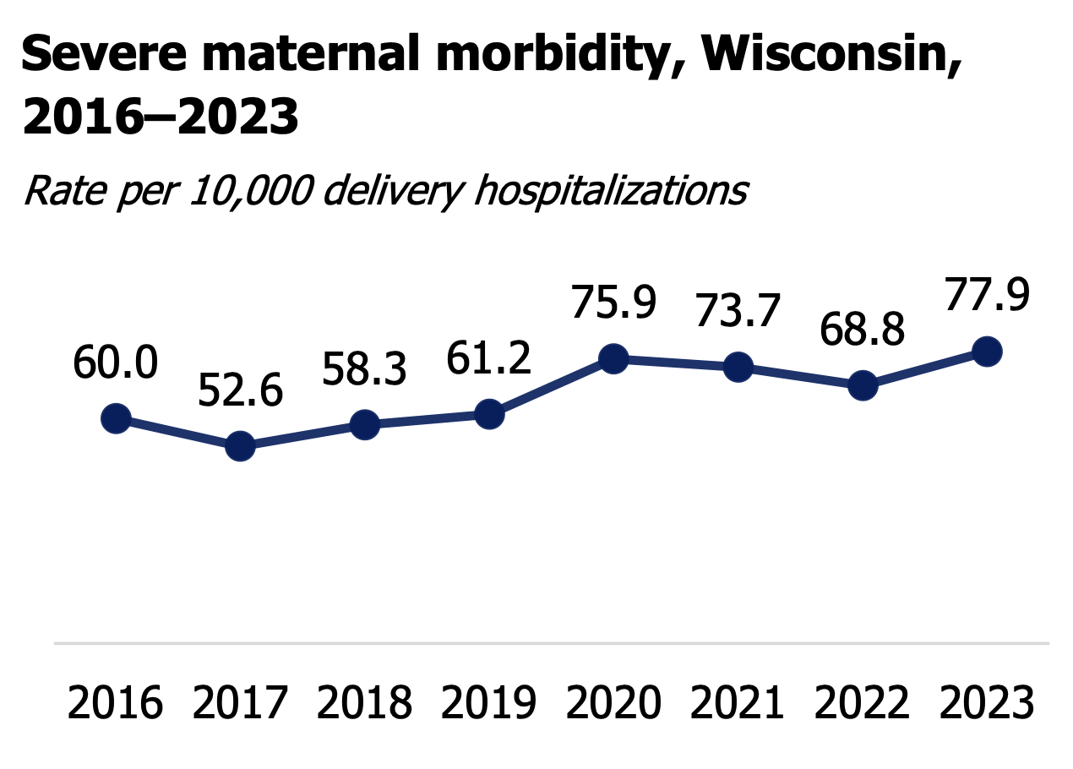
https://www.dhs.wisconsin.gov/publications/p01125-2016-2023.pdf

Slide 12
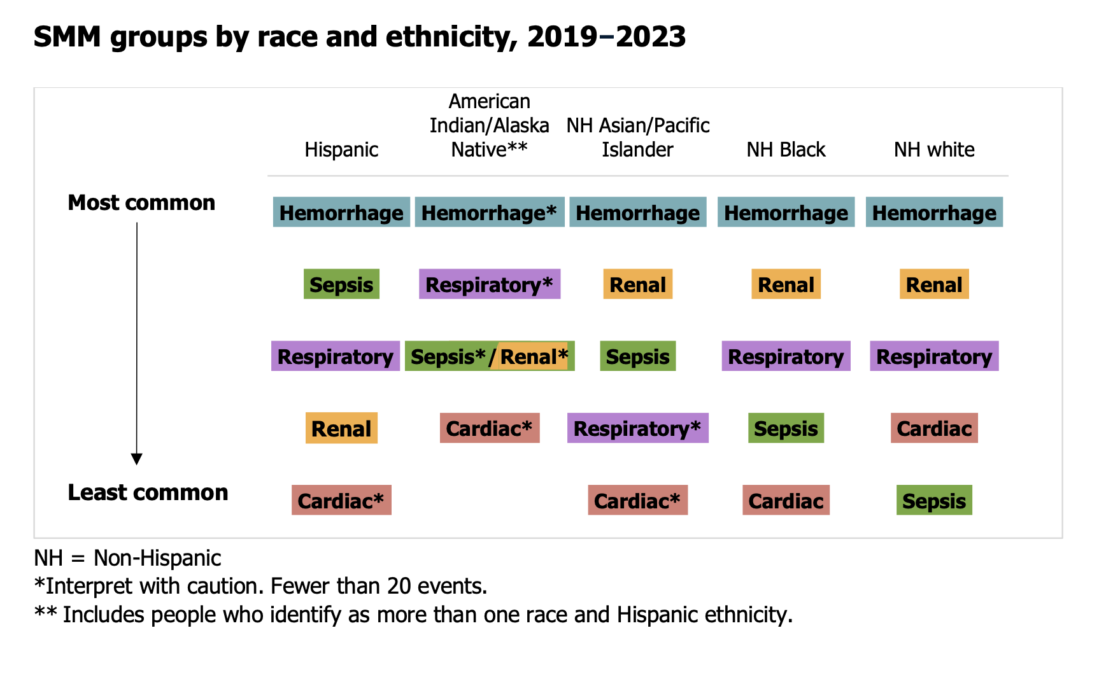
https://www.dhs.wisconsin.gov/publications/p01125-2016-2023.pdf

Slide 13
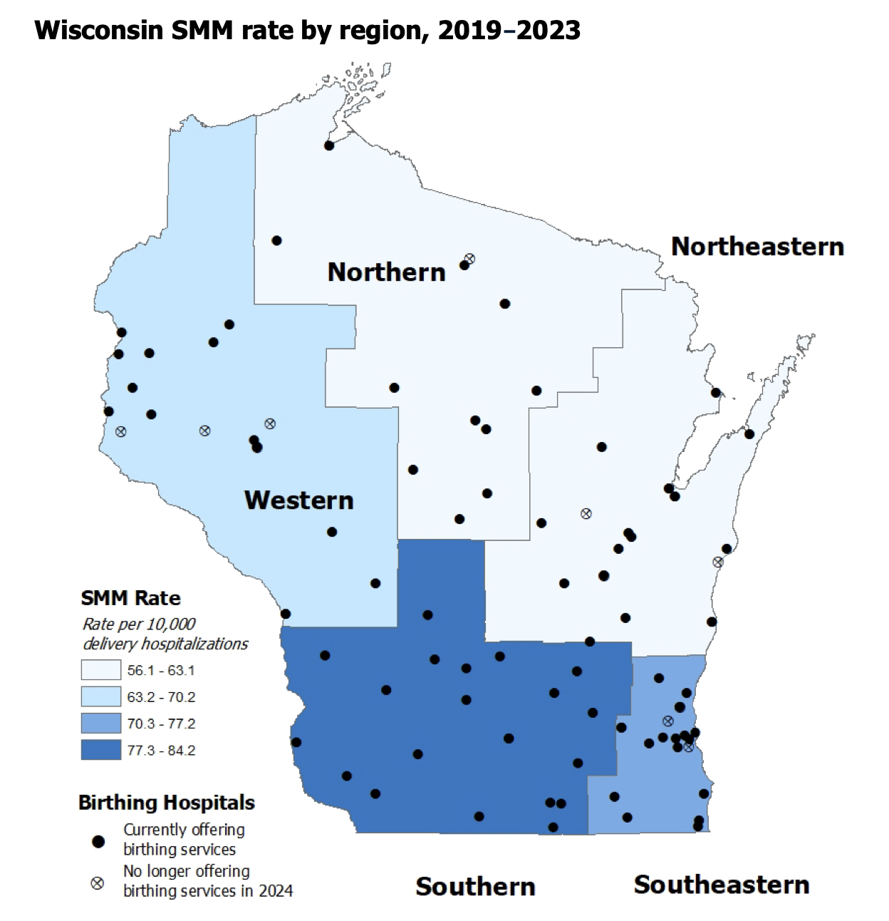

Slide 14
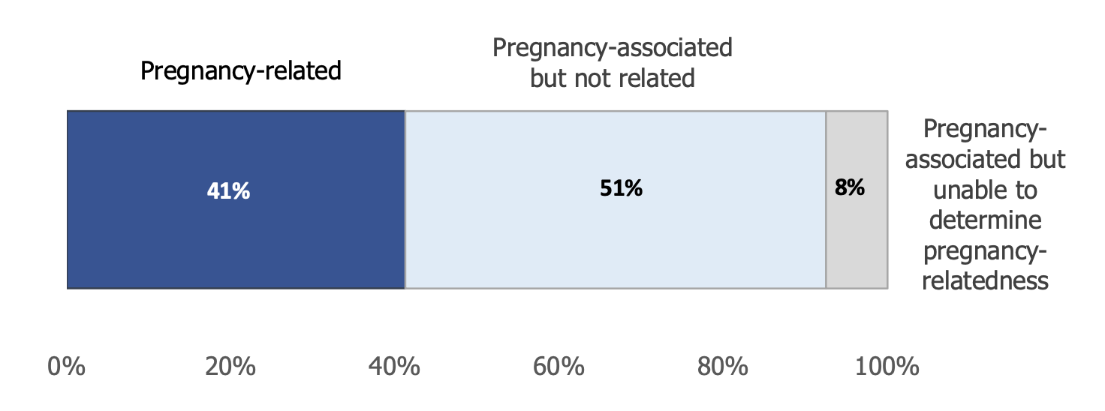
Maternal Mortality
Maternal Death
Pregnancy-related Death
Pregnancy-associated
Death
Death of a woman while pregnant or within 42 days of the end of pregnancy due to a cause related to or worsened by pregnancy or its management
Death during the pregnancy or within 1 year of the end of pregnancy, that was caused by a pregnancy complication or chain of events initiated by the pregnancy, or a condition or event that was aggravated by the pregnancy
Death during the pregnancy or within 1 year of the end of pregnancy that was attributable to conditions where the pregnancy was unlikely to have an impact on the course of the condition or event
https://www.dhs.wisconsin.gov/publications/p03226.pdf

Slide 15
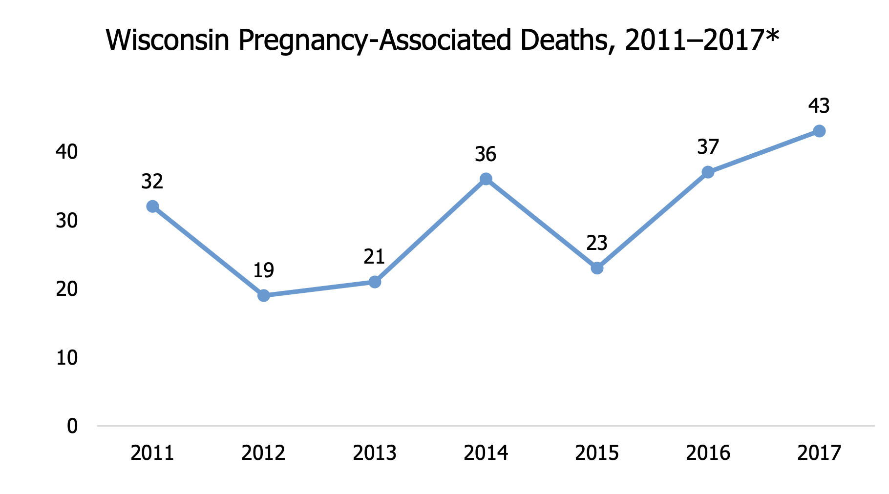
https://www.dhs.wisconsin.gov/publications/p03226.pdf

Slide 16
Wisconsin Pregnancy-Related Deaths: Causes
https://www.dhs.wisconsin.gov/publications/p03226.pdf

Slide 17
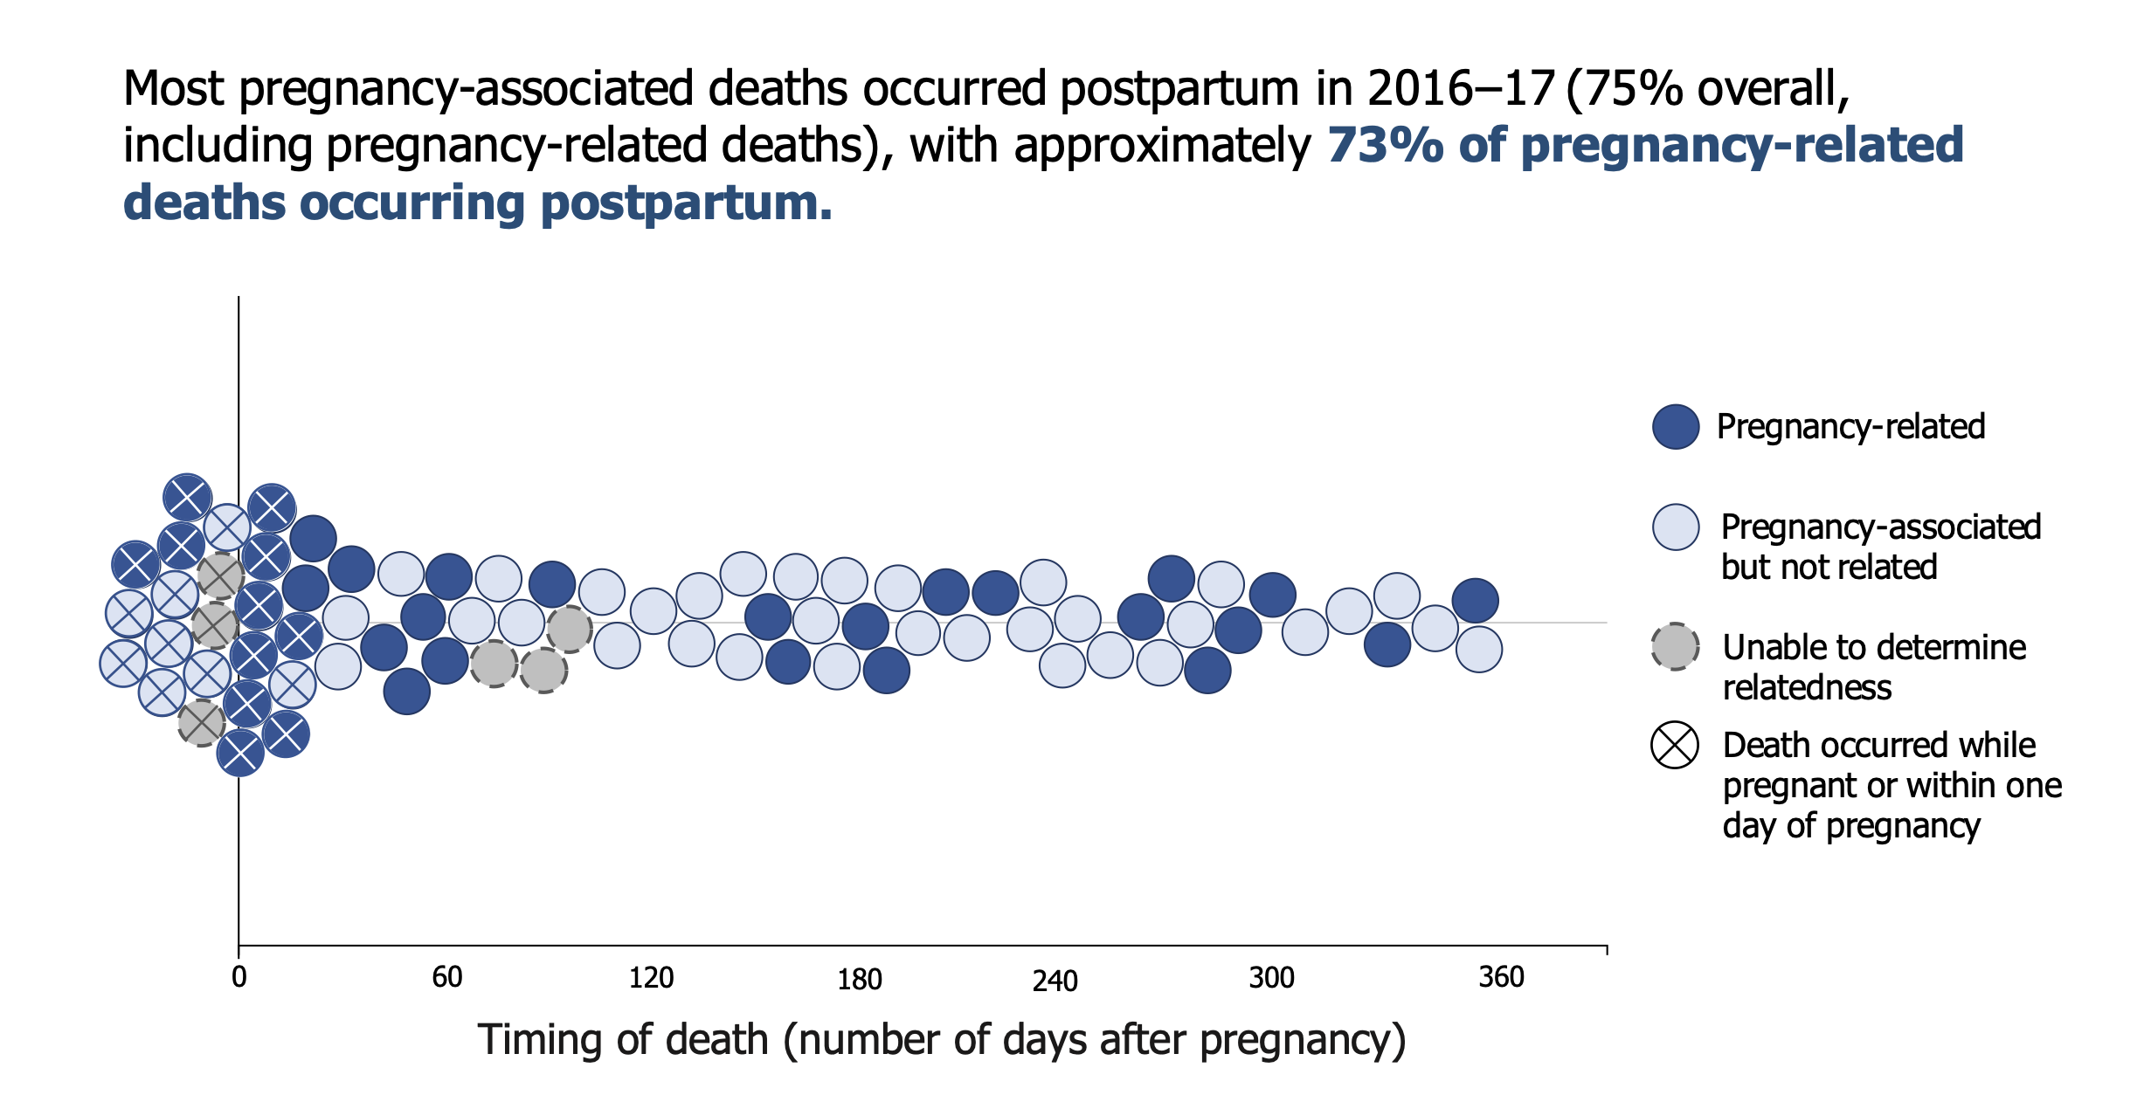
https://www.dhs.wisconsin.gov/publications/p03226.pdf

Slide 18
Rural Obstetrics

Slide 19
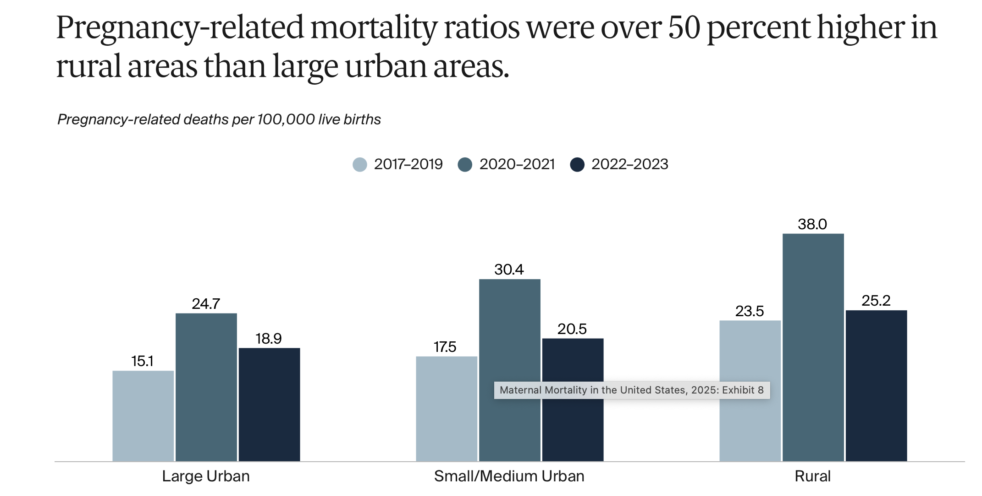

Slide 20
Maternal Care Deserts: Key Facts
20,000,000 Americans live in counties without a practicing OB/GYN (46.9% of all counties surveyed)
6% of live births in US in 2021 occurred in counties w/out an OB
https://www.marchofdimes.org/sites/default/files/2024-09/2024_MoD_MCD_Report.pdf

Slide 21

Rural Obstetric Services: Other Factors
Difficulty recruiting and retaining providers
Poor reimbursement
Lack of ancillary services
Lack of subspecialty physicians
Inability to flex staffing
Lack of resources to respond to OB emergencies
Chen, V., Ying, X., Majdinasab, E., & Theiler, R. (2026 Geographic disparities in obstetric care: access in the United States. Obstetrics & Gyncecology, 147, 422-424. )

Slide 22
Rural OB: Wisconsin
70% of rural hospitals that deliver babies utilize more than 1 type of provider
OB, Family Practice, General Surgeons
11 Wisconsin hospitals closed OB services in previous 10 years
99% of women of child-bearing age live within a 30-minute drive-time for hospital-based OB care
Does not account for birth centers or level of care needed

Slide 23
14% decrease in rural births
47% of Critical Access Hospitals provide OB services (40% national average)
Most common reasons for OB unit closure - provider coverage, low birth volumes, low reimbursement rate
Wisconsin Office of Rural Health
https://worh.org/wp-content/uploads/2024/08/2024-OB-Report_13Aug2024.pdf

Slide 24
Strategies for Rural Response to OB Emergencies

Slide 25


Slide 26
Rural Response
Recognize
Stabilize
Call
Treat
Transfer

Slide 27


Strategy #1
Emergency Department
Notes:
We have permission to use this picture

Slide 28


Slide 29
OB Patients in ED
Prior to Prenatal Care
SAB
Hyperemesis
Non-Obstetric Causes
Cholecystitis
Appendicitis
Obstetric Causes
Hemorrhage
Hypertensive Disease
Postpartum
Shortness of breath
Wound infection

Slide 30
Emergency Birth in Rural Hospitals Without OB Services
2018 American Hospital Association random sample survey
69 rural hospital EDs responded
65% located >30 miles away from hospital with OB services
28% had an emergency birth in past year
32% had adverse birth outcome
22% delay in urgent transport
90% had capacity for blood transfusion, IV antibiotics, anticonvulsants, and basic neonatal resuscitation
16% had capacity to perform surgery
80% reported need for additional training or resources to handle OB emergencies
Kozhimannil, KB, et al (2021) J Rural Health

Slide 31
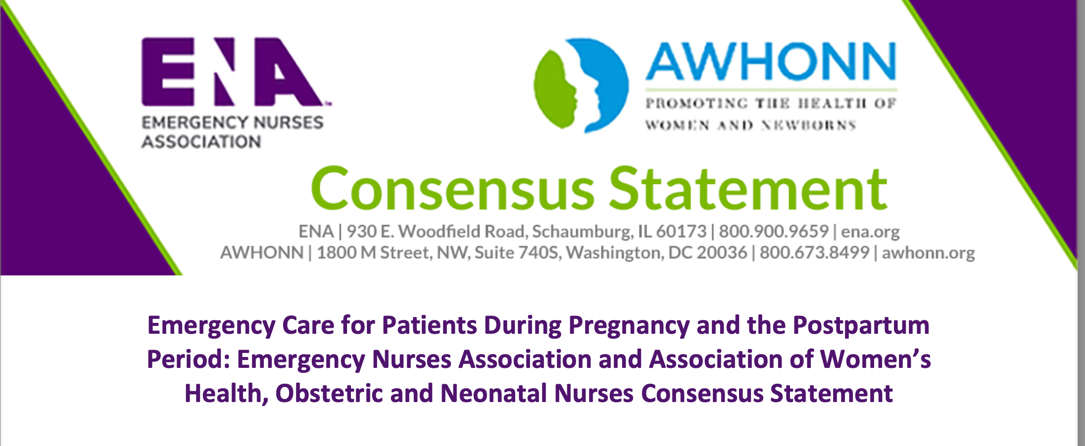

Slide 32
OB Patients in ED
Emergency nurses recognize the possibility that a woman of reproductive age, regardless of presenting symptoms, may be pregnant or may have been pregnant in the past year.
Education and training provided for emergency and obstetric nurses include common high-risk and life- threatening obstetric presentations, early warning signs of maternal compromise, and protocol management.
ENA AWONN, 2020

Slide 33
OB Patients in ED
Hospital-based policies identify gestational age and weeks postpartum to determine timely consultation and/or an appropriate plan of care and disposition of the patient.
For example, the policy may include gestational age parameters that indicate whether a patient is evaluated in the emergency room or an obstetric care setting.
ENA AWHONN, 2020

Slide 34
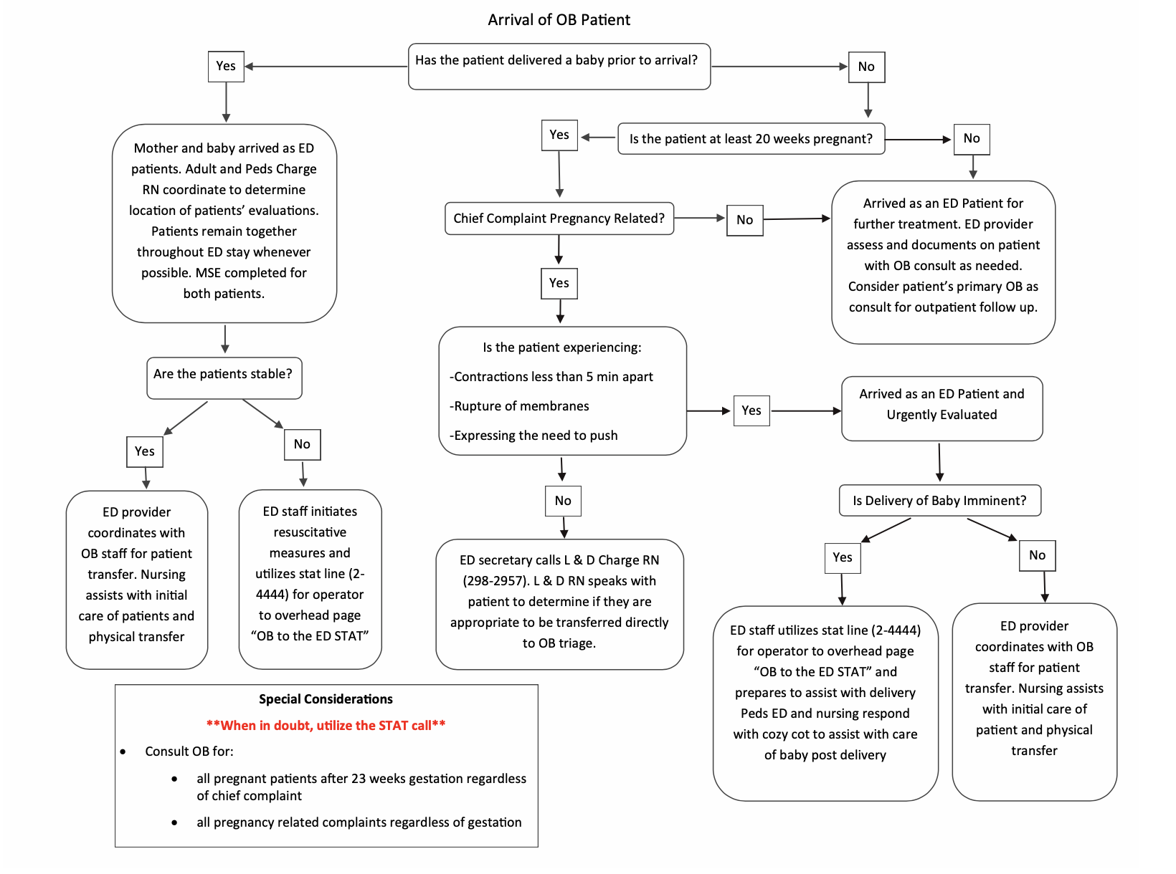
Proactive
not
Reactive
Notes:
Coordination with EMS

Slide 35
OB Patients in ED
Stabilizing, emergent care procedures, including radiologic examination, surgery, and/or medication administration are not delayed due to pregnancy or postpartum status, gestational age, or lactation status.
Emergency facilities maintain immediate access to equipment, supplies, and medications necessary to properly assist with precipitous birth, resuscitative cesarean delivery, and postpartum complications.
ENA AWHONN, 2020

Slide 36
CMS New Obstetrical Services Conditions of Participation
Emergency Services Readiness
Transfer Protocols
Organization, Staffing, and Delivery of Services
Training for Obstetrical Staff in Hospitals and Critical Access Hospitals
Quality Assessment and Performance Improvements

Slide 37
Strategy #2
Screening During Prenatal Care
Notes:
We have permission to use this picture

Slide 38
Screening Examples
Placenta Accreta Spectrum
Cardiac Disorders
Placenta Previa
Bleeding Disorder

Slide 39
Strategy #3
Maternal Early Warning Criteria
Notes:
We have permission to use this picture

Slide 40
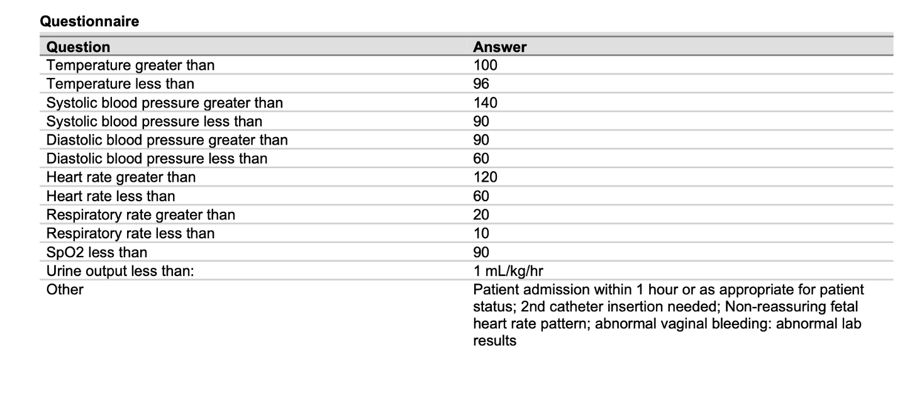

Slide 41

What Are Early Warning Criteria?
“ . . . a set of predetermined ‘calling criteria’ (based on periodic charting of vital signs) as indicators of the need to escalate monitoring or call for assistance”

Slide 42
Maternal Early Warning Criteria
Effective Escalation Policy
Prompt reporting
Prompt bedside evaluation and interventions

Slide 43
National Partnership for Maternal Safety Criteria: Maternal Early Warning Signs (MEWS)
SBP < 90 or >160
DBP >100
HR < 50 or >120
RR < 10 or > 30
SpO2 < 95%
Oliguria mL/hr ≥ 2hrs less than 35 mL
Agitation, confusion, unresponsiveness
Preeclampsia: SOB, unrelenting HA
Mhyre, J.M. et al (2014). The maternal early warning criteria: a proposal from the national partnership for maternal safety. JOGNN,

Slide 44
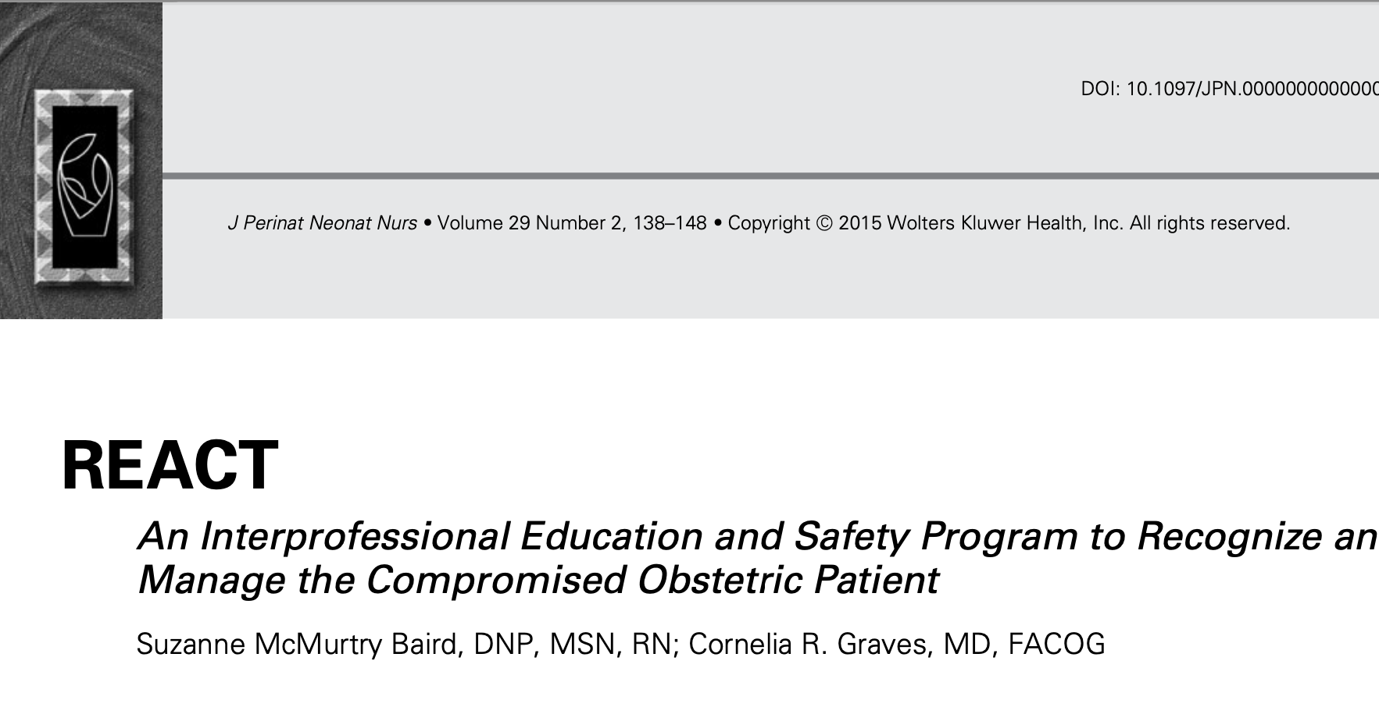

Slide 45
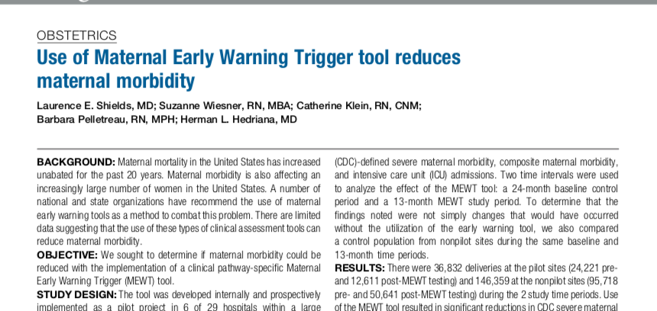

Slide 46
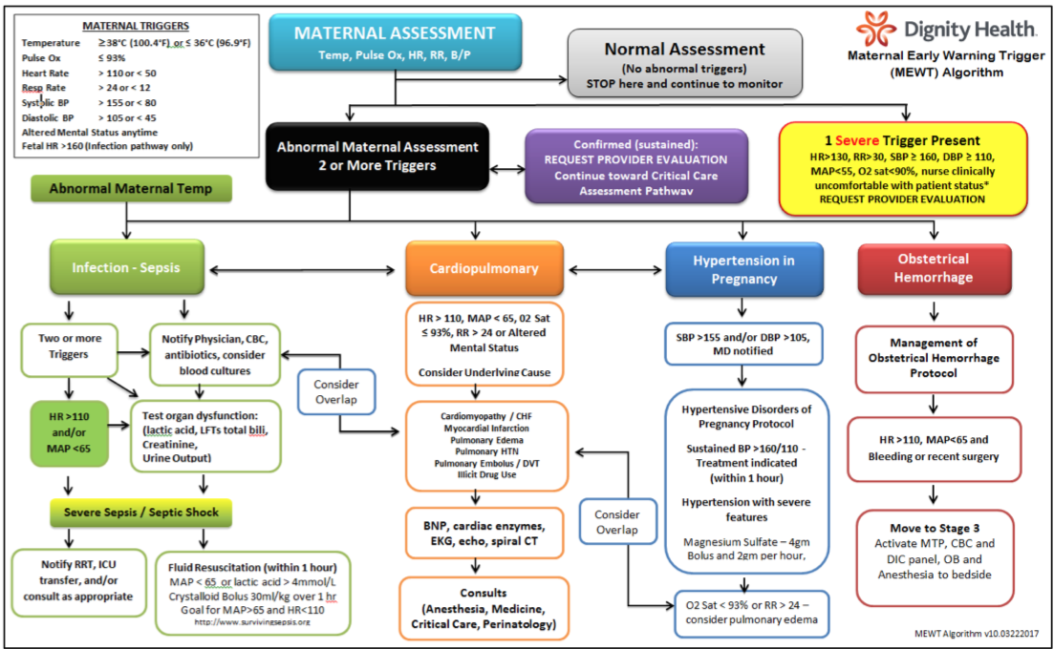
Shields et al. Use of maternal early warning trigger tool reduces maternal morbidity. Am J Obstet Gynecol 2016;214:527.e1-6.

Slide 47
Maternal Early Warning Trigger (MEWT) Algorithm
Infection/Sepsis
ACTION
Cardio-Pulmonary
ACTION
Hemorrhage
ACTION
Hypertension
ACTION
Shields et al. Use of maternal early warning trigger tool reduces maternal morbidity. Am J Obstet Gynecol 2016;214:527.e1-6.

Slide 48
Maternal Early Warning Trigger (MEWT) Algorithm
18% decrease in CDC-defined SMM
14% decrease in composite morbidity
Shields et al. Use of maternal early warning trigger tool reduces maternal morbidity. Am J Obstet Gynecol 2016;214:527.e1-6.

Slide 49
Maternal Early Warning Tool
Tool that works for your hospital
Dependent on resources
Consistency in utilization
Follow the tool

Slide 50
Strategy #4
Define and Understand Scope of Services
Notes:
We have permission to use this picture

Slide 51


Slide 52
Proactive: Defined Scope of Service
Defines the patients you will care for on your unit and those who will be transported/transferred off.
Based on patient population and facility capabilities

Slide 53
Example: Scope of Services Service
Currently admitted at a Level II maternal care hospital without
24/7 cardiothoracic surgery coverage
Marfan’s Syndrome
28 weeks
Aortic root dilated to 4.7 cm
Transported to a Level IV maternal care facility

Slide 54
Strategy #5
Determine Maternal Level of Care
Notes:
We have permission to use this picture

Slide 55
Levels of Maternal Care (2019

Slide 56
Levels of Maternal Care: Objectives
Uniform designations for levels of maternal care that are complimentary but distinct from levels of neonatal care
Develop standard definitions and nomenclature for facilities
Provide consistent guidelines of service according to level of maternal care for use in quality improvement and health promotion
Foster development and equitable geographic distribution of full-service maternal care facilities and systems that promote proactive integration of risk-appropriate antepartum, intrapartum and postpartum services

Slide 57
“Your level of care is not determined by how sick your patients are. It is determined by how prepared you are for those sick patients.”
-Stephanie Martin, DO

Slide 58
Levels of Maternal Care
Birthing Center
Level I
Level II
Level III
Level IV
Minimum primary delivery provider to be available
Obstetrics surgeon
MFM
Director of Obstetric Services
Anesthesia
Consultants
ICU
Level I

Slide 59
Wisconsin Maternity Hospitals
3
10
14
23
Level IV
Level III
Level II
Level I
Regional perinatal centers
Subspecialty care
Specialty care
Basic care
Number of hospitals by maternal level of care
Level IV
3 hospitals
Level III
10 hospitals
Level II
14 hospitals
Level I
23 hospitals
Source: Wisconsin Association for Perinatal Care (WAPC) self-assessment data

Slide 60
Levels of Maternal Care
“All facilities need to have the capability to stabilize and provide initial care for any patient while being able to accomplish transfer if needed and, thus, must have resources to manage the most common obstetric emergencies such as hemorrhage and hypertension.”
Defined Scope of Services
Transport system and processes
Receiving hospitals openly accept patient transports
Appropriate level of care driven by care needs – not financial
Level of maternal care may not match neonatal level of care

Slide 61
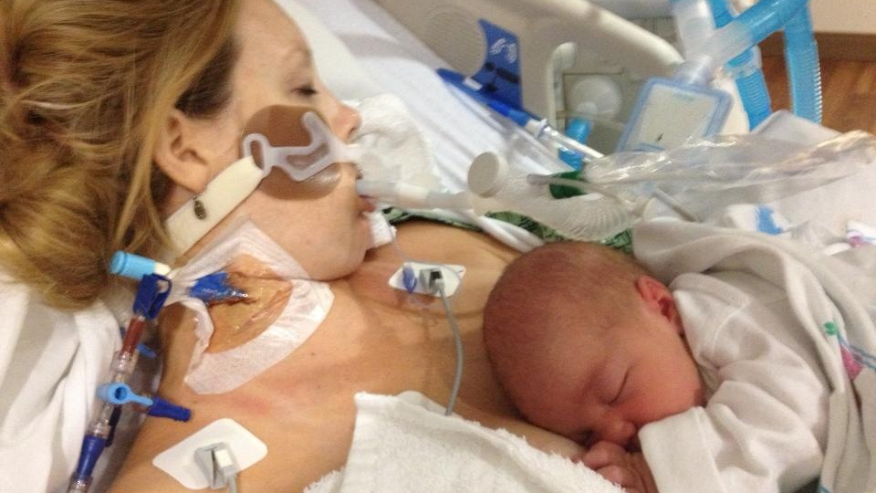

Slide 62
Levels of Maternal Care
Availability of MFM (28%)
OB Anesthesiologist (16%)
OB ultrasound services (12%)
41% of hospitals self-reported a higher LoMC than their LOCATe®-assessed LoMC
Madni SA, et al. CDC LOCATe: discrepancies between self-reported level of maternal care and LOCATe-assessed level of maternal care among 463 birth facilities. J Perinatol 2022;42:589–94.

Slide 63
Levels of Maternal Care
Inappropriate Level of Care Worsens Outcomes
64,441 deliveries in MA in 2019
1/3 had at least 1 of 16 defined high-risk conditions
Prior CD (49%; 10,443/21,415) was most common risk condition
Term preeclampsia without severe features was 2nd most common (28%; 5965/21,415)
Of these high-risk patients, 13% (4% of entire population) delivered at an inappropriate level of care
48% (994/2082) of those requiring level IV care received inappropriate care
Osei-Poku GK et al. Delivery at an inadequate level of maternal care is associated with severe maternal morbidity. AJOG 2024 Mar 2:S0002-9378(24)00421-6

Slide 64

Severe Maternal Morbidity 3.3 X More Likely
Osei-Poku GK et al. Delivery at an inadequate level of maternal care is associated with severe maternal morbidity. AJOG 2024 Mar 2:S0002-9378(24)00421-6

Slide 65
Strategy #6
Maternal Transport System
Notes:
We have permission to use this picture

Slide 66
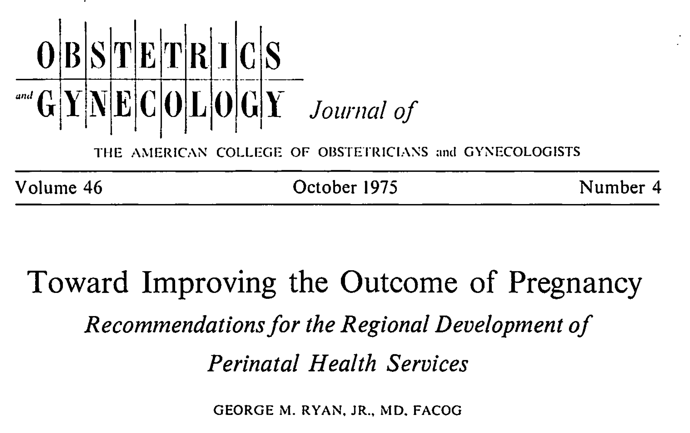
Stimulated development of regionalized perinatal care systems (maternal and neonatal transport programs)

Slide 67
Regionalized Perinatal Care System: Goals
Delivery of neonate in facility best equipped to meet its needs
Avoid neonatal transport
Transfer of mother to facility best equipped to meet her needs

Slide 68
Regional Partnerships
Larger
Hospital
Rural Hospital
Rural Hospital
Rural Hospital
Rural Hospital
Depending on condition, diagnosis, and facility capabilities high-risk provider can collaborate on plan of care with OB for patient to stay in rural hospital for birth.

Slide 69
Maternal Medical/Surgical Indications for Transport
Trauma
Diabetes
Infection/sepsis
Respiratory complications
Cardiovascular disease
Renal disease
Connective tissue disorders
Coagulopathy/complications of hemorrhage
Neurologic abnormalities
Liver disease
Drug overdose
Psychiatric emergencies
Acute abdomen
Anything outside your scope of service

Slide 70



Maternal Transport
Transport to another facility may be necessary
Stabilization efforts before transport are crucial
Intubate if necessary
Transfuse blood products
Treat hypertension
Transport process should already be established
70

Slide 71
Maternal Transport
The transferring hospital must:
Provide ongoing care within its capability until transfer to minimize transfer risks
Provide copies of medical records
Confirm that the receiving facility has space and qualified personnel to treat the condition and has agreed to accept the transfer
The transfer must be made with qualified personnel and appropriate medical equipment

Slide 72
Maternal Transport: Determining Stability
Stability is a judgment that the patient’s condition is not expected to deteriorate substantially during the transfer process.
EMTALA: stability for transfer determined by physician or qualified medical provider evaluating the patient.
If patient is unstable, document that benefits outweigh risks.
Providers at the transferring facility should initiate treatment and stabilization efforts prior to transport.

Slide 74
Strategy #7
Standardized Treatment Protocols
Notes:
We have permission to use this picture

Slide 75

“Hope is not a strategy.
Luck is not a plan.”

Slide 76
Standardized Treatment Protocols
Hypertension Eclampsia
Cardiac Disease
Hemorrhage and MTP
Respiratory Compromise
Maternal Sepsis

Slide 77
Example: Maternal Sepsis in Low Resourced Settings
Low Resourced Settings
Inability to measure lactate level, use capillary refill and urine output to guide resuscitation
Respiratory Therapy early involvement in care | Monitor for hypoxemia with early intervention
Peripheral administration of vasopressors until central line placement
Early antibiotic administration with possible sepsis without shock | Limited lab and diagnostic testing
Administration of antibiotics in ambulance or flight
Source control within 6 hours (max) | Determined by resources and clinician

Slide 78
Strategy #8
Simulation
Notes:
We have permission to use this picture

Slide 79

What is your nightmare scenario?
Do you feel prepared to handle it?
Have you practiced it?

Slide 80
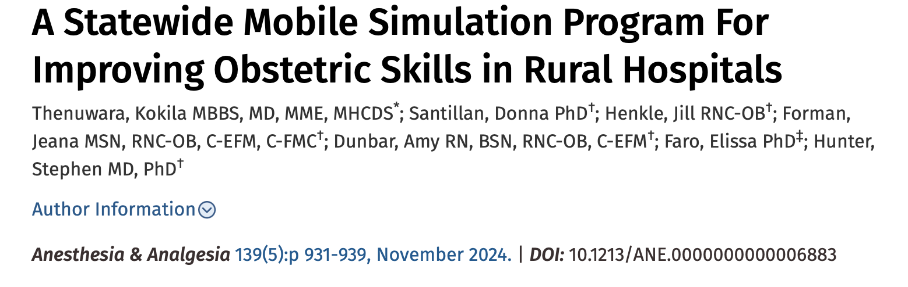
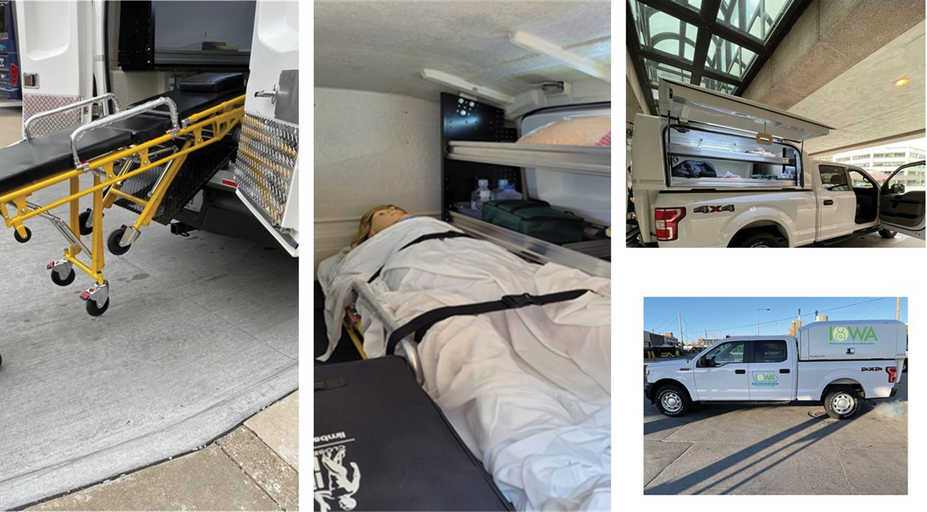
Simulation: Rural Settings
Potential Limitations
Resources
Equipment
Clinician availability
Training

Slide 81

Other Solutions for Rural Hospitals

Slide 82
Remote Consultation and Telehealth
Video consultation
Genetic counseling
Real time interactive US
Mental Health Services

Slide 83

Mobile Care

Slide 84
Current Project:
Improving Care for Pregnant and Postpartum People with Substance Use Disorder
Wisconsin PQC
Previous Project:
Maternal Hypertension

Slide 85


Slide 86
What Did We Learn Today?
Current data regarding maternal morbidity and mortality in the US
Need for standardization
Importance of a Plan

