Slide 1
Caring for Refugee Families
in the Perinatal Journey: Compassion, Culture, and Clinical Excellence
presented by
Nancy Huhta Comello
DNP, CNM, RNC-OB/MNN, C-EFM/ONQS, FAWHONN
Unity Point Health-Meriter Hospital & University of Wisconsin Health, Obstetrics Outreach Educator
Founder & Executive Director, Supporting Safe Birth, Inc

Slide 2
I have no disclosures to report

Slide 3
Overview
I. Introductions
II. Definitions: Refugee or immigrant or migrant
III. Childbearing data for refugee families in the U.S.
IV. Challenges in nursing care for refugee families
Vulnerable populations
Role-playing clinical situations
V. Advocacy by nurses
VI. Advancing AWHONN’s Global Health Leadership in Nursing
VII. Summary
Notes:
Introductions
Definitions: Refugee or immigrant or migrant
Childbearing data for refugee families in the U.S.
What is a sustainable global project for low-resource areas?
Application to U.S. settings
Challenges in nursing care for refugee families
Vulnerable populations
Role-playing clinical situations
Advocacy by nurses
Summary

Slide 4
Learning Objectives
Participants will identify nursing interventions that demonstrate cultural humility and safety.
Participants will be able to recognize challenges unique to refugee families
Participants will identify strategies to expand nursing engagement in global health initiatives

Slide 5
Do not edit How to change the design
What word comes to mind when you hear the word “refugee”?
The Slido app must be installed on every computer you’re presenting from

Slide 6
Childbearing Data for Refugee Families in the U.S.
Approximately one in every four births in the United States is to a person who is an immigrant or a non-U.S. citizen (CDC, 2022)
2024:100,000 refugees were admitted to the United States - more than the total in 2022 and 2023 combined
Tend to be younger than the native-born population
Median age of 20 for those arriving in 2022
Nationalities have changed. Venezuelan refugees increased 71-fold from 160 in 2022 to 11,350 in 2024
Over the last 10 years, the U.S. has admitted 469,830 refugees
Leading countries of nationality for refugees admitted
The Democratic Republic of the Congo
Afghanistan
Venezuela
Syria
https://ohss.dhs.gov/topics/immigration/refugees/annual-flow-report/fy-24-refugees-flow-report Gibson, 2022
Notes:
Country of Nationality
In 2024, the 4 leading countries of nationality for individuals admitted as refugees made up 57% of total refugee admissions (Table 3). Top nationalities in 2024 included:
Democratic Republic of the Congo (20%)
Afghanistan (15%)
Venezuela (11%)
Syria (11%)
The nationalities of refugees admitted to the United States have changed as U.S. policies have evolved and new conflicts have arisen throughout the world. Venezuelan refugees increased 71-fold from 160 in 2022 to 11,350 in 2024.
Over the last 10 years, the United States has admitted 469,830 refugees. Top nationalities included:
Democratic Republic of the Congo (23%)
Burma (13%)
Syria (11%)
Iraq (7.4%)
Somalia (6.7%)
In 2024, the United States admitted 100,060 refugees, more than the total refugees admitted in both 2022 and 2023 combined.

Slide 7
Childbearing Data for Refugee Families in the U.S.
Immigrants now make up roughly 15.4% of the total U.S. population, a level near the historical record of 14.8% set in 1890.
The United States provided protection to 36,615 asylees during 2022; increased to 54,350 individuals in 2024
The leading countries of nationality for persons granted asylum
People’s Republic of China, Venezuela, and El Salvador
The U.S. is home to more international migrants than any other country, 17-20% of all immigrants
More than the next four countries:
Germany, Saudi Arabia, Russia, and the United Kingdom combined.
In 2026 U.S. immigrant population represents about 4.2% of the total world population
Immigrants now comprise 15.4% of the total U.S. population
Historical record =14.8% in 1890.
American Immigration Council, 2026; Gibson, 2022
Notes:
Country of Nationality
In 2024, the 4 leading countries of nationality for individuals admitted as refugees made up 57% of total refugee admissions (Table 3). Top nationalities in 2024 included:
Democratic Republic of the Congo (20%)
Afghanistan (15%)
Venezuela (11%)
Syria (11%)
The nationalities of refugees admitted to the United States have changed as U.S. policies have evolved and new conflicts have arisen throughout the world. Venezuelan refugees increased 71-fold from 160 in 2022 to 11,350 in 2024.
Over the last 10 years, the United States has admitted 469,830 refugees. Top nationalities included:
Democratic Republic of the Congo (23%)
Burma (13%)
Syria (11%)
Iraq (7.4%)
Somalia (6.7%)
s of 2026, the United States population represents approximately 4.2% of the total world populati

Slide 8
Definitions
Refugee | Immigrant | Migrant
A person who is unable or unwilling to return to their country of nationality (or country of last habitual residence, if stateless) because of persecution or a well-founded fear of persecution on account of race, religion, nationality, membership in a particular social group, or political opinion | Person(s) with no U.S. citizenship at birth Includes naturalized citizens, lawful permanent residents, refugees and asylees, people on certain temporary visas, and unauthorized immigrants Used interchangeably with foreign-born | Any person who changes his or her country of usual residence Moving or have moved across an international border, regardless of legal status, duration of the stay abroad, and causes for migration

Slide 9
ACOG Committee Statement (2023)
“Policies that infringe on the health and rights of immigrants and limit access to health care, anti-immigrant rhetoric, and punitive immigration -enforcement activities all have detrimental effects on health” (ACOG, 2023)
ANA Issue Brief (2010)
“…Health care is a basic human right for all people and issued a resolution stipulating that all individuals living in the US—documented or not— should have access to health care.” (ANA, 2010a).
“Nursing’s professional ethics advocate for the care of individuals, families, communities, and populations and recognize the moral worth and dignity of all people regardless of their personal attributes or life situation” (ANA, 2010b; ANA, 2015)
Notes:
How does this affect us as nurses? There are some policies from ACOG and the ANA.
“Policies that infringe on the health and rights of immigrants and limit access to health care, anti-immigrant rhetoric, and punitive immigration -enforcement activities all have detrimental effects on health” (ACOG, 2023)
“…Health care is a basic human right for all people and issued a resolution stipulating that all individuals living in the US—documented or not— should have access to health care.” (ANA, 2010a).
“Nursing’s professional ethics advocate for the care of individuals, families, communities, and populations and recognize the moral worth and dignity of all people regardless of their personal attributes or life situation”

Slide 10
Cultural Competence vs Cultural Humility vs Cultural Safety
Cultural Competence Introduced in the 1980s
Focus on attending to the culturally diverse backgrounds of patients, providing person-centered care, and reducing health disparities
May cause social stereotypes and an imbalance of power between patients and the healthcare team
Oversimplified understanding of other cultures may lead to wrong assumptions about individual patients
Examples?
Lekas et al., 2020
Notes:
Cultural Competence
Attending to the culturally diverse backgrounds of patients, providing person-centered care, and reducing health disparities
Can cause social stereotypes and an imbalance of power between patients and the healthcare team
Cultural Humility
Admitting that one does not know and is willing to learn from patients about their experiences, while being aware of one’s own culture(s) equalizing the patient-caregiver relationship
Can improve communication and quality of care
Cultural humility trainings are process-oriented and aim to enhance providers’ capabilities to deliver patient-centered care, with content-oriented and aim to increase providers’ knowledge, confidence and self-efficacy in communicating with and treating diverse patient
Talks of abandoning the term Competence is in circles of advocates
Role play: Dehlia

Slide 11
Provi Optimal Care for Refugee Families?
Cultural competence did not begin to appear consistently in the healthcare literature until the early 1990s.
Nurses and doctors were told that “cultural competency” is key to caring for patients of different cultures
Cultural competency classes and books often provided
stereotypes of cultural differences
One nurse noted she knew Hispanic patients “over-express the pain they are feeling” because she learned this in a course she had taken
Notes:
Example in ED: Latino patients were half as likely as white patients to receive analgesia for the same, usually very painful, long bone fractures.
Cultural competence did not begin to appear consistently in the healthcare literature until the early 1990s.
Nurses and doctors were told that “cultural competency” is key to caring for patients of different cultures
Cultural competency classes and books often provided stereotypes of cultural differences
One nurse noted she knew Hispanic patients “over-express the pain they are feeling” because she learned this in a course she had taken
Need self-reflection and commitment to lifelong learning = cultural humility
Flexibility and humility
Treating every patient as an individual

Slide 12
Cultural Humility
The concept of cultural humility was developed in 1998 by Dr. Melanie Tervalon and Dr. Jann Murray-García.
An alternative to cultural competence
Address health disparities and provide a framework for heath professionals to engage in self-reflection, lifelong learning, and to address power imbalances
Admitting that one does not know and is willing to learn from patients about their experiences, while being aware of one’s own culture(s), equalizes the patient-caregiver relationship
Can improve communication and quality of care
Flexibility, humility, and treating every patient as an individual
(Tervalon & Murray-Garcia, 1998)

Slide 13
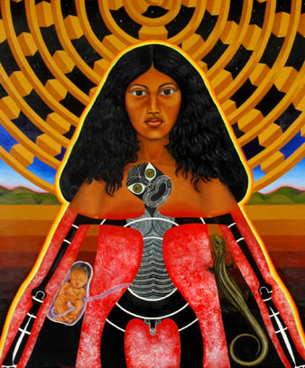
Cultural Safety
Identified in 1990s in New Zealand by Māori nurses to address power imbalances, structural inequalities, and ensure health services are respectful of Māori culture, values, and worldviews
“Nursing or midwifery action to protect from danger and/or reduce risk to patient/client/community from hazards to health and well-being” (Papps & Ramsden, 1996, p 493).
Any action or lack of action that does not respect the ethnocultural background of individuals, groups, and communities or demeans their racial background is culturally unsafe (Papp & Ramsden, 1996).
There is widespread discrimination in nursing and other health professions
Due to a combination of displacement-related trauma, systemic barriers to healthcare, and socioeconomic disadvantage minority women refugees in the U.S. have a higher risk:
Emergency cesarean birth
Food insecurity
Perinatal depression/anxiety
Intimate partner violence
Low Apgar scores.
Te whānau tamariki –
pregnancy and birth
https://teara.govt.nz/en/te-whanau-tamariki-pregnancy-and-birth
Rayment-Jones et al, 2026;
Notes:
Māori women traditionally gave birth in specially built shelters. There were rituals to observe and karakia to recite. Mothers sang oriori to their babies – lullabies which told whakapapa, legends and tribal history.

Slide 14
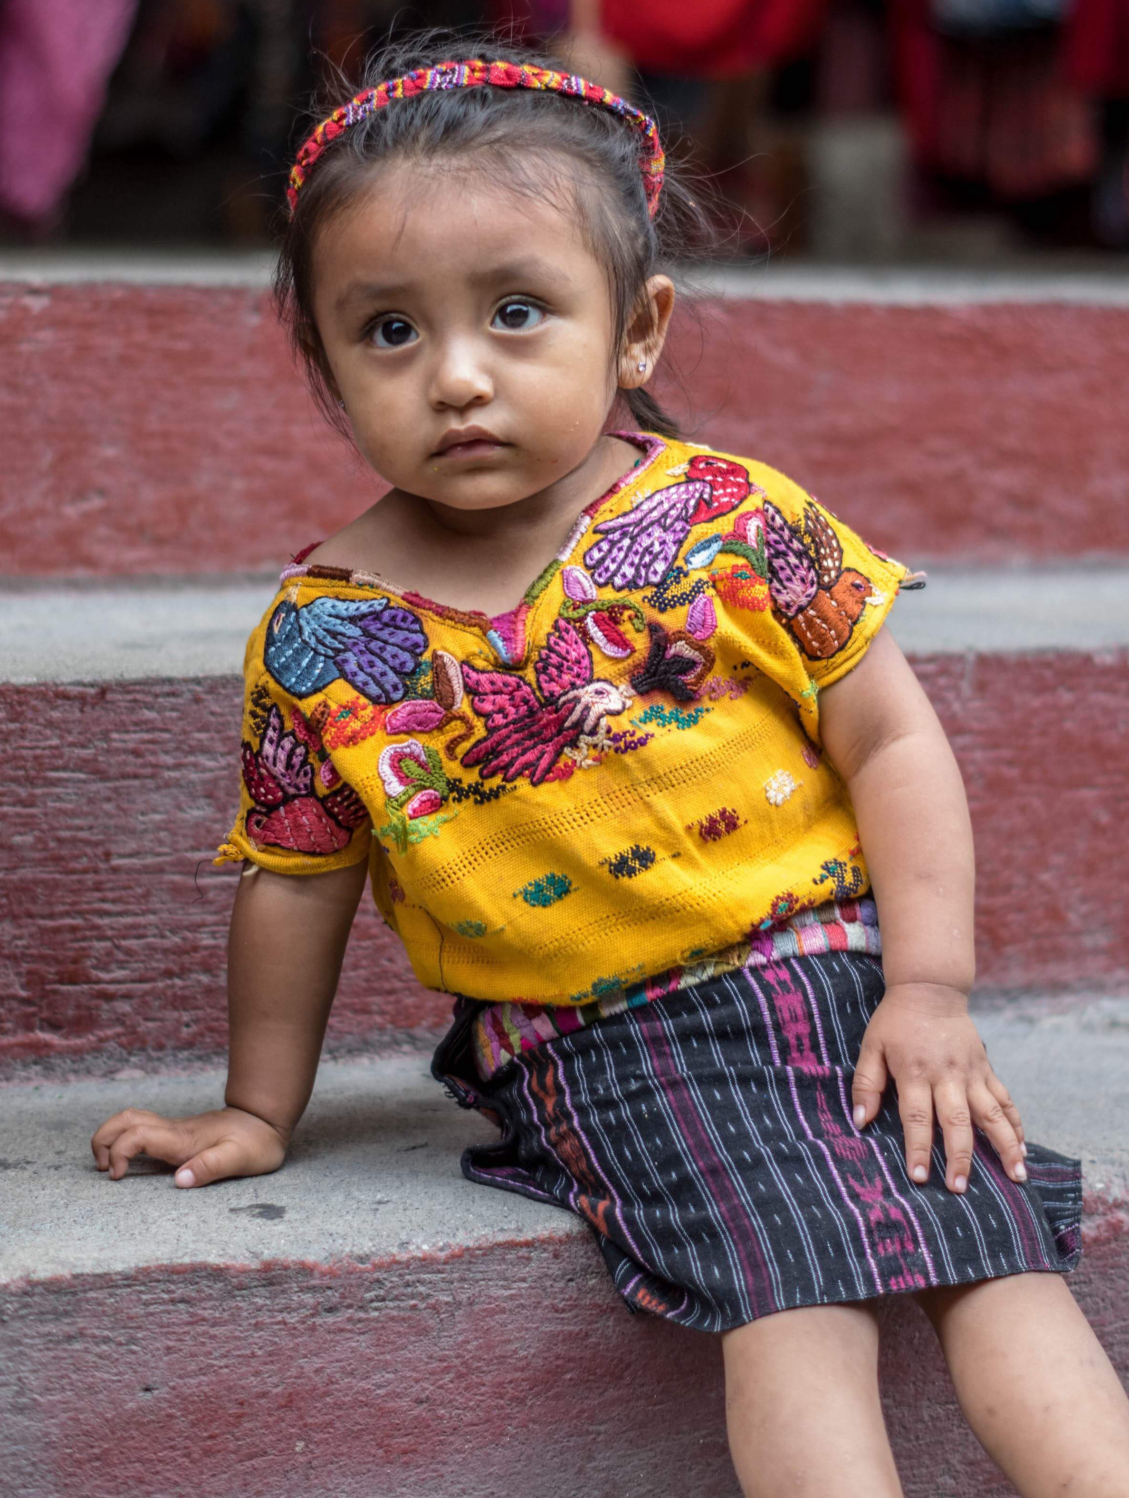
A Shift toward Cultural Safety
Essential to improve cultural safety interventions to remediate inequities in care
Engagement needed from healthcare practitioners, healthcare organizations, and health systems
Instead of prioritizing becoming competent in the cultures of others, it is crucial to critique the power imbalances and engage in critical self-reflection
Cultural safety training needed
The overall goal is to achieve health equity for all groups and the elimination of indigenous and ethnic health inequities.
Comello, N. 2024 San Marcos La Laguna. Used with permission
Curtis et al, 2019

Slide 15
How Nurses Demonstrate Cultural Safety
Acknowledge differences
Ask the patient about their culturally specific needs or any specific accommodations
Recognition of differences leads to individualized care
The women feel valued, respected, and that their needs were being met because their providers understand and accept their needs
Acknowledging differences
The first step toward feelings of mutual respect that prompts women to return for care
Egger et al, 2024

Slide 16
How Nurses Demonstrate Cultural Safety
2) Encourage the presence of their community
Additional support systems are especially important during the perinatal period due to many strong traditions and family practices
Many women experience a strong desire to return to their culture during pregnancy
Connection with health providers is strong if they share similar life experiences
As opposed to the racism and disrespect many have experienced during birth
Example: automatic drug testing based on ethnicity
Egger et al, 2024

Slide 17
How Nurses Demonstrate Cultural Safety
3) Value culture-based choices and knowledge
Express confidence in how patients are navigating pregnancy, birth, or postpartum.
Accept their choices about their care, demonstrating concrete respect
Support from a provider was not only encouraging but a sign of safety, especially if their choices conflicted with standard medical advice
For example, present care options without judgment and leave decisions up to the patient
Post pictures of minority pregnant women as examples of healthy pregnancies, to counteract negative cultural stereotypes
Egger et al, 2024

Slide 18
Refugee Role-Playing Scenario
Setting: A crowded shelter for refugees and asylum seekers in Del Rio Texas
Characters
Maria Luisa - A pregnant Cuban refugee who recently arrived in the country seeking asylum and traveled through Mexico.
Gretchen - A staff member at the shelter where Maria is staying. Gretchen just returned from a vacation to Mexico.
Notes:
Refugee Role-Playing Scenario
NARRATOR:
Setting: A crowded shelter for refugees and asylum seekers in Del Rio Texas
Characters:
Maria - A pregnant Cuban refugee who recently arrived in the country seeking asylum after traveling through Mexico.
Gretchen- Staff member at the shelter where Maria is staying who just came back from a trip to Mexico.
Narrator: will translate any Spanish used
Scenario:
Scene opens with Maria sitting alone in a corner of the shelter, looking distressed. The shelter is bustling with people coming and going.
Maria: Rubbing her swollen belly, looking around nervously
Gretchen: To herself she says” I took a Spanish crash course class before my trip and I can speak a little Spanish and I will try to help her”. [Approaches Maria with a clipboard in hand] Buenas tardes, Maria. ¿Cómo te encuentras hoy?
NARRATOR: Good afternoon, Maria. How are you feeling today?
Maria: [Forced smile] Bien, gracias. Solo un poco cansada.
NARRATOR: Good, thank you. Just a little tired.
Gretchen: [Notices Maria's discomfort] Um Let me see I think I know this one” She states LOUDLY:
¿Estás segura? Pareces preocupada.
NARRATOR: Are you sure? You seem worried.
Maria: [Sighs] Es solo que... me siento triste y un poco fuera de lugar aquí.
NARRATOR It's just that... I feel sad & a bit out of place here.
Gretchen: [Concerned] ¿Qué pasa? No entiendo sus palabras.
NARRATOR: What's wrong? I don’t understand the words.
Gretchen: That Babel app and course just may not be the best after all. I am going to try Google translate.
Maria: [Hesitant] Bueno... es solo que algunas personas aquí no han sido muy amables conmigo.
NARRATOR Well... it's just that some people here haven't been very friendly to me.
Gretchen: [Frowns and visibly struggling responds LOUDLY in front of the group ] Lo siento mucho, Maria. Nadie debería sentirse así aquí. ¿Puedes decirme? Despacito por favor
NARRATOR I'm really sorry, Maria. No one should feel that way here. Can you tell me please but slower?
Maria: [Nods but proceeds to speak fast in Spanish ] Bueno, algunas personas han estado haciendo comentarios sobre mi embarazo y mi situación como refugiada. Me siento juzgada y discriminada.
NARRATOR Well, some people have been making unpleasant comments about my pregnancy and my refugee status because I am from Cuba and not from Mexico or Central America and I am in a different queue than them. I feel judged and discriminated against by my own.
Gretchen: [Struggling but loudly to get her words out in Spanish ] ¡Qué terrible! Voy a ayudar te!
NARRATOR That’s terrible! I am going to get you help!
Maria: (Confused) Que dice ella?
NARRATOR. Did she say she was going to help me?
NARRATOR: Gretchen walks away proud that she addressed the situation while Maria tries to compose herself and feels just as confused and upset that this staff member just confused her and embarrassed that was speaking loudly in front of the others about her situation [End of scene]
This role-play scenario can be expanded by examining the resolution of the discrimination issue and the steps taken by the shelter staff.
Does Maria feel safe and supported during her stay?
It highlights the challenges faced by pregnant refugees, particularly in environments where discrimination and prejudice may be present, and underscores the importance of empathy

Slide 19
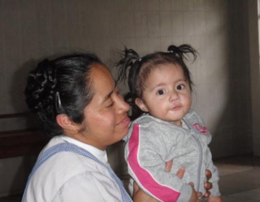
8 Challenges & Opportunities in Nursing Care for Refugee Families
1) Higher risks of stillbirth, perinatal and neonatal morbidity and mortality
2) Isolation and loss of existing social support systems
3) History of trauma
4) Limited language skills and unavailability of language interpreters
Low literacy and educational levels
5) Barriers to health literacy and access to care
6) Cultural and religious differences
7) Lack of trust in the health care system
8) Experiences of bias and racism and discrimination
(American Psychiatric Association, n.d.)
Comello, N. 2020. San Marcos La Laguna. Used with permission
Notes:
1) Higher risks of stillbirth, perinatal and neonatal morbidity and mortality
2) Isolation and loss of existing social support systems
3) History of trauma
4) Limited language skills and unavailability of language interpreters
Low literacy and educational levels
5) Barriers to health literacy and access to care
6) Cultural and religious differences
7) Lack of trust in the health care system
8) Experiences of bias and racism and discrimination

Slide 20
1) Higher Risks of Stillbirth and Perinatal & Neonatal Morbidity & Mortality
ACOG Committee Statement
Anti-immigrant attitudes and fear of immigration-enforcement activities have detrimental effects on health
Documented an increased rate of complications
Preterm birth and low birth weight
Self-report of sadness
Anxiety and nervousness
Decreased use of health care in affected communities
Immigrants may arrive with poorly controlled communicable diseases (WHO, n.d.)
Maternity care is often the first point of contact with health systems for females
Refugee health is also related to the social determinants of health
Employment, income, education, and housing
ACOG Committee Statement 2023; APA, n.d.; WHO, n.d.
Notes:
ACOG Committee Statement
Anti-immigrant attitudes and fear of immigration-enforcement activities have detrimental effects on health
Documented increased rate of complications
Preterm birth and low birth weight
Self-report of sadness
Anxiety and nervousness
Decreased use of health care in affected communities
Immigrants may arrive with poorly controlled communicable diseases (WHO, n.d.)
Maternity care is often a first point of contact with health systems for females
Refugee health is also related to the social determinants of health
Employment, income, education, and housing

Slide 21
1) Higher Risks of Stillbirth and Perinatal & Neonatal Morbidity & Mortality Recommendations
Identify the family’s experiences and provide support
Assess mental health status
Make resources and information available –see resource list
Encourage families to find out about their rights
Encourage families to prepare an emergency plan - childcare
Encourage self-advocacy
Links to legal and social services can assist patients in learning how to practice self-advocacy
Recognize the effects of ICE
Pregnant immigrant women skipping or delaying appointments or having their partners deported –which can also mean losing financial support
Lack of access → reduced birth weight, preterm births, other pregnancy complications. (Feldscher, 2026)
APA, n.d.; Barrios-Ruiz et al, 2024
Notes:
pregnant immigrant women skipping or delaying appointments, or having their partners deported—which can also mean losing financial support. Experts quoted noted that lack of access to maternal care has been linked with health issues such as reduced birth weight, pre-term births, and other pregnancy-related complications.
Recommendations
Identify the family’s experiences and provide support
Assess mental health status.
Make resources and information available
Encourage families to find out about their rights
Encourage families to prepare an emergency plan - childcare
Encourage self-advocacy
Links to legal and social services can assist patients in learning how to practice self-advocacy

Slide 22
2) Social Isolation and 2) Loss of Existing Social Support Systems
Immigration-related stressors can increase suicidal thoughts and risk due to the distress associated with cultural stress and social marginalization
Adequate social support is the most important protective factor for undocumented immigrants’ mental health
Shifting family structures and dynamics
Strained family situations with inclusions, exclusion, and desires for assimilation among family members
Shifting priorities can lead to increased intergenerational conflicts
Separation from family
Traumatic for children to be separated from parents
When reunited, children may respond to feelings of abandonment by rejecting their parents → can create a self-perpetuating cycle
APA, n.d.; Barrios-Ruiz et al, 2024
Notes:
Immigration-related stressors can increase suicidal thoughts and risk due to the distress associated with cultural stress and social marginalization
Adequate social support is the most important protective factor for undocumented immigrants’ mental health
Shifting family structures and dynamics
Strained family situations with inclusions, exclusion, and desires for assimilation among family members
Shifting priorities can lead to increased intergenerational conflicts
Separation from family
Traumatic for children to be separated from parents
When reunited, children may respond to feelings of abandonment by rejecting their parents → can create a self-perpetuating cycle

Slide 23


2) Loss of Existing Social Support Systems Recommendations
Encourage and advocate for the unification of patients with their families
Connect patients and families to resources
Social support is crucial for the recovery of disenfranchised populations
Collaborate with community organizations
Support for undocumented immigrants in multiple areas of their lives, including family and school support
See resource list
Refugee Council USA
Notes:
Recommendations
Encourage and advocate for unification of patients with their families
Connect patients to resources
Social support is crucial for the recovery of disenfranchised populations
Collaborate with community organizations that support undocumented immigrants in multiple areas of their lives, including family and school support
See resource list

Slide 24
3) History of Trauma: Trauma and Stressors Before, During, and After Immigration
High risk of violence & sexual abuse
Housing instability
What do we know about trauma?
Traumatic stress reactions
Post Traumatic Stress Disorder (PTSD)
Unable to trust others, especially the U.S. legal system
Many providers have little – no training in trauma-informed care
Therapy options in your community
UNIDOS, Madison, WI – Bilingual hotline & therapists for children & adults
APA, n.d.; Barrios-Ruiz et al, 2024; WHO, n.d.
Notes:
High risk of violence & sexual abuse
Housing instability
What do we know about trauma?
Traumatic stress reactions
Post Traumatic Stress Disorder (PTSD)
Unable to trust others, especially the U.S. legal system
Many providers have little – no training in trauma-informed care

Slide 25
3) History of Trauma Trauma and Stressors Before, During, and After Immigration Recommendations
Consider recovery from trauma as a primary goal
Screen for trauma exposure and symptoms
Use a normalizing statement:
”Many people I care for have experienced violence or trauma”
Ask about anxiety, depression, substance use, and sleep disorders
Recognize the impact of violence and coping measures (or lack thereof)
Allow patients to tell their stories
Recreating their story often helps immigrants process and prevent symptoms of depression, anxiety, and PTSD
Also helps people identify their story in a less damaging and more therapeutic way
Consider re-examining policies that restrict access to social services and health care for the undocumented
APA, n.d.; Barrios-Ruiz et al, 2024; WHO, n.d.
Notes:
Recommendations
Consider recovery from trauma as a primary goal
Screen for trauma exposure and symptoms
Use normalizing statement:
”Many people I provide care to have a history of violence or trauma.”
Anxiety, depression, substance use and sleep disorders
Recognize impact of violence and coping measures (or lack thereof)
Allow patients to tell their stories
Recreating their story often helps immigrants process and prevent symptoms of depression, anxiety, and PTSD
Also helps people identify their story in a less damaging and more therapeutic way
Consider re-examining policies that restrict access to social services and health care for the undocumented

Slide 26
4) Limited Language Proficiency Low Literacy and Educational Levels
Studies show women have difficulties in understanding and being understood
Understanding written language is difficult
Leads to misunderstandings with health care providers
Unsure about information over the phone or websites
Inability to express themselves correctly causes concern and frustration
ACOG Committee Statement reviews language proficiency challenges
Offer patients interpreters and materials available in languages appropriate for the patient population
Lack of proficiency prevents them from obtaining information on how to navigate the health care system
Causes anxiety, fear, insecurity, and embarrassment, which discourages them from attending cancer screenings, family planning centers, or prenatal care
Tendency to rely on information from other women in their community
ACOG, 2023; APA, n.d.; Barrios-Ruiz et al, 2024; WHO, n.d.
Notes:
Studies show women have difficulties in understanding and being understood
Understanding written language is difficult
Leads to misunderstandings with health care providers
Unsure about information over the phone or websites
Inability to express themselves correctly causes concern and frustration
ACOG Committee Statement reviews language proficiency challenges
Offer patients interpreters and materials available in languages appropriate for the patient population
Lack of proficiency prevents them from obtaining information on how to navigate the health care system
Causes anxiety, fear, insecurity, and embarrassment, which discourages them from attending cancer screenings, family planning centers, or prenatal care
Tendency to rely on information from other women in their community

Slide 27
4) Limited Language Proficiency- Low Literacy and Educational Levels Recommendations
Use professional interpreters whenever possible, not family members
Minimize language barriers
Attempt to offer resources in patients’ native languages
Provide opportunities to learn English if patients show an interest
Avoid medical terminology and jargon
Use simple vocabulary, free of technical terms and understood by women with no schooling
Explain concepts and techniques with photos and simple drawings
Be very cautious recommending books or websites to receive advice and using Google translate or other apps – sometimes they are very wrong
Encourage patients to express their needs, expectations, and concerns about health
ACOG, 2023; APA, n.d.; Barrios-Ruiz et al, 2024; WHO, n.d.
Notes:
Recommendations
Use professional interpreters whenever possible, not family members
Minimize language barriers
Attempt to offer resources in patients’ native languages
Provide opportunities to learn English if patients show an interest
Avoid medical terminology and jargon
Use simple vocabulary, free of technical terms and understood by women with no schooling
Explain concepts and techniques with photos and simple drawings
Be cautious recommending books or websites to receive advice and using Google translate or other apps – sometimes they are very wrong
Encourage women to express their needs, expectations, and concerns about health

Slide 28
5) Barriers to Health Literacy & Access to Care
Refugees and immigrants are among the most vulnerable members of society (WHO, n.d.)
Lack of knowledge of English prevents access for immigrants
Difficulty obtaining information about how to navigate the health care system
Understanding invitations for screening opportunities
Communicating with health care providers
Lack of access to health insurance
Higher overall risk for mental health issues for some undocumented immigrants
Immigrants with a higher number of traumatic exposures
Undocumented Latinos are more likely to have multiple psychosocial problems (Perez, 2005).
APA, n.d.; Ramos et al, 2005; Barrios-Ruiz et al, 2024; WHO, n.d.
Notes:
Refugees and immigrants are among the most vulnerable members of society (WHO, n.d.)
Lack of knowledge of English prevents access for immigrants
Difficulty obtaining information about how to navigate the health care system
Understanding invitations for screening opportunities
Communicating with health care providers
Lack of access to health insurance
Higher overall risk for mental health issues for some undocumented immigrants
Immigrants with a higher number of traumatic exposures
Undocumented Latinos are more likely to have multiple psychosocial problems (Perez, 2005).

Slide 29
5) Barriers to Health Literacy & Access to Care Recommendations
Provide information on navigating the health care system
Identify public health resources - provide invitations to screening programs
Review and practice how to communicate with health care providers
Recognize that websites may not be used by immigrant populations
Acknowledge that preventive health care was often not usual in their home countries
Facilitate communication
Most requested ways to facilitate access of services by refugees:
1) Health education
Access of professional interpreters, preferable female
Translation of written information in simple and accessible way
Increased cultural humility of practitioners
APA, n.d.; Barrios-Ruiz et al, 2024; WHO, n.d.
Notes:
Recommendations
Provide information on navigating the health care system
Identify public health resources - provide invitations to screening programs
Review and practice how to communicate with health care providers
Recognize that websites may not be used by immigrant populations
Acknowledge that preventive health care was often not usual in their home countries
Facilitate communication
Most requested ways to facilitate access of services by refugees
1) Health education
Access of professional interpreters, preferable female
Translation of written information in simple and accessible way
Increased cultural humility of practitioners

Slide 30
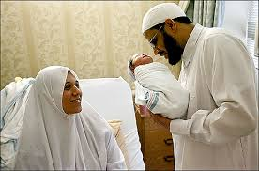
6) Cultural and Religious Differences
ACOG Committee Statement
Demonstrating respect for cultural health beliefs and traditions
Obstetric and gynecologic care should be culturally inclusive
Some immigrants face discrimination because of their religion, resulting in detrimental mental health effects
Women reject clinical practices when they conflict with their religious beliefs
Imposing U.S. cultural values on sexual and reproductive health care is a crucial barrier for using health services
Cultural differences from U.S.
Fatalistic view of cancer, fear of talking about it, and the shame of being diagnosed
Diseases are “God’s will”
Children are a gift – no contraceptives
APA, n.d.; Barrio-Ruis, 2023; WHO, n.d.
Notes:
ACOG Committee Statement
Demonstrating respect for cultural health beliefs and traditions
Obstetric and gynecologic care should be culturally inclusive
Some immigrants face discrimination because of their religion, resulting in detrimental mental health effects
Health care providers often discourage women from adhering to specific rituals around childbirth, such as food preferences, performing an adhan (ritual where the Muslim father recites a prayer in the ear of the newborn) after birth
Women reject clinical practices when they conflict with their religious beliefs
Imposing U.S. cultural values on sexual and reproductive health care is a crucial barrier for using health services
Women can be reluctant to come to consultations when they had experiences of misunderstandings with practitioners, such as their decision to not use contraception or judgments against their female genital mutilation (FGM)
Cultural differences from U.S.
Fatalistic view of cancer, fear of talking about it, and the shame of being diagnosed
Diseases are “God’s will”

Slide 31
6) Cultural and Religious Differences Recommendations
Spirituality and faith should be assessed and incorporated into treatment planning if the patient desires
Consider community, culture, and societal factors that influence mental health
Ex. Religious holidays, fasting during Ramadan
Identify cultural mores
Lack of awareness of the cultural customs of individual ethnic groups can result in negative repercussions
For example: Shaking hands may create unwanted physical contact with men
Others?
APA, n.d.; Barrios-Ruiz et al, 2024; WHO, n.d.
Notes:
Recommendations
Spirituality and faith should be assessed and incorporated into treatment planning if the patient desires
Consider community, culture,and societal factors that influence mental health
Identify cultural mores
Lack of awareness of cultural customs of individual ethnic groups can result in negative repercussions
For example: Shaking hands may create unwanted physical contact with men

Slide 32
7) Lack of Trust in the Health Care System
Immigrants often have no access to health care
Lower paying jobs which are less likely to offer health coverage
Many experience unfair treatment when seeking health care and difficulty accessing respectful and culturally appropriate care
Immigration-related fears
Linguistic barriers (Phillai et al, 2023)
Migrant women often believe that they do not receive all the information they need to understand in their encounters with providers
Nonverbal language can create trust or mistrust that may impact health services’ access
The competence and communication style of the practitioner is important
Refugees find female physicians demonstrate more patient-centered communication
Greater empathy, higher expression of emotions, and they perceive the visits are also longer
APA, n.d.; Barrios-Ruiz et al, 2024; WHO, n.d.
Notes:
Immigrants often have no access to health care
Lower paying jobs which are less likely to offer health coverage
Many experience unfair treatment when seeking health care and difficulty accessing respectful and culturally appropriate care
Immigration-related fears
Linguistic barriers (Phillai et al, 2023)
Migrant women often believe that they do not receive all the information they need to understand in their encounters with providers
Nonverbal language can create trust or mistrust that may impact health services’ access
The competence and communication style of the practitioner is important
Refugees find female physicians demonstrate more patient-centered communication
Greater empathy, higher expression of emotions, and they perceive the visits are also longer

Slide 33
7) Lack of Trust in the Health Care System Recommendations
Treating immigrant women in a professional and respectful manner is key to communicating effectively
Practice patient-centered & cultural humility by asking every woman about her needs and preferences
There is significant variability in attitudes and beliefs among women from shared ethnic and religious groups
Provide consistent and accessible follow-up
Because of their distrust of the health care system undocumented immigrants may require more frequent and consistent follow-up to create a sense of trust.
Collaborative decision-making and motivational interviewing can be helpful if it is performed with cultural sensitivity
APA, n.d.; Barrios-Ruiz et al, 2024; WHO, n.d.
Notes:
Recommendations
Treating immigrant women in a professional and respectful manner is key to communicating effectively
Practice patient-centered & cultural humility by asking every woman about her needs and preferences
There is significant variability in attitudes and beliefs among women from shared ethnic and religious groups
Provide consistent and accessible follow-up
Because of their distrust of the health care system undocumented immigrants may require more frequent and consistent follow-up to create a sense of trust.
Collaborative decision-making and motivational interviewing can be helpful if it is performed with cultural sensitivity

Slide 34
8) Experiences of Bias, Racism, and Discrimination
Overt and subtle acts of racism and discrimination
Poor treatment, verbal and physical attacks as a result of marginalization, and disparities in healthcare and academics
Racism is a widespread cause for decreased access to health services
For example, women with female genital mutilation (FGM) have been criticized, rejected, and punished, and often report suboptimal care.
Racial profiling and suspicion towards immigrants
Can lead to fear, anxiety, isolation, and safety concerns
Implicit/explicit bias and microaggressions
Can significantly affect individuals, whether intentional or not
Examples:
Health care providers complaining when immigrants publicly speak languages other than English
“Were you born here? But you speak so well.”
APA, n.d.; Barrios-Ruiz et al, 2024; WHO, n.d.
Notes:
Overt and subtle acts of racism and discrimination
Poor treatment, verbal and physical attacks as the result of marginalization and disparities in healthcare and academics
Racism is an important cause for decreased access to using health services
For example, women with female genital mutilation (FGM) have been criticized, rejected, and punished and often report suboptimal care.
Racial profiling and suspicion towards immigrants
Can lead to fear, anxiety, isolation, and safety concerns
Implicit/explicit bias and microaggressions
Can significantly affect individuals, whether intentional or not
Example:
Health care providers complaining when immigrants publicly speak languages other than English
“Were you born here? But you speak so well.”

Slide 35
8) Experiences of Bias, Racism, & Discrimination Recommendations
Examine our own implicit and explicit biases
Regular training that promotes reflective self-examination and awareness of implicit bias
Skillful interpreters build bridges of communication
Empathetic non-verbal actions can break down linguistic and cultural barriers
If a cultural practice does not violate human dignity or human rights, it should be respected, including in the clinical setting
APA, n.d.; Barrios-Ruiz et al, 2024; WHO, n.d.
Notes:
Recommendations
Examine our own implicit and explicit biases
Regular training that promotes reflective self-examination and awareness of implicit bias
Skillful interpreters build bridges of communication
Empathetic non-verbal actions can break down linguistic and cultural barriers
If a cultural practice does not violate human dignity or human rights, it should be respected, including in the clinical setting

Slide 36


Application to Clinical Situations Role-Playing
2 other refugee patients today with varying situations

Slide 37
Case 1: Luzette
Luzette, age 21, G1, P1, age 21, baby girl is born at 39 4/7 weeks.
She is an immigrant from Ghana; she has been in the U.S since age 16 but has limited exposure to American culture. She just arrived in your city.
The baby was transferred to the NICU at 24 hours of life due to hyperbilirubinemia. She was found to have methemoglobinemia and genetic testing was recommended. Labs were sent.
Luzette was discharged at 2 days postpartum. Today she arrives alone to see her baby in the NICU at 6 days postpartum. She does not know where her husband is.
The NICU RN is concerned about the pelvic pain Luzette is experiencing and takes her to the Emergency Department to be evaluated.
After 10 hours she spends in the ED the OB resident determines she has severe range BPs and needs to be transferred to postpartum for magnesium sulfate.
Luzette appears quite uncomfortable but has difficulty describing her pain.
We’ll begin this scenario with the NICU RN in the ED.
Ethnicity: Akan
Primary language
Akan (Twi/Fante); limited English
Stock photo

Slide 38
Discussion
What are the social determinants of health impacting Luzette?
The doula expressed her concern about emotional abuse from husband.
Significant food insecurity
Primary language: Akan’
Lives with her extended family. Her mother and close family members remain in Africa
Limited English and extremely low health literacy
Has never been to a hospital or clinic before
What does low health literacy look like?
Luzette didn’t fully understand what preeclampsia was or the implications of it
She also did not understand that admission means getting an IV – what is an IV?
Luzette asked, What is blood pressure? How does the machine work to find the BP? Why is it a problem if it is too high?

Slide 39
Discussion
Other Issues
The ER phoned the dad without talking to her (likely because of the language/cultural barriers) which most likely worsened her anxiety/stress and blood pressure
She also had an oversupply of milk and hadn’t been pumping in almost 5 hours, which also caused her great risk of mastitis and overall discomfort.
Nurses have the power to completely change this woman’s experience
How would you improve this patient’s experience?
What do we say?

Slide 40
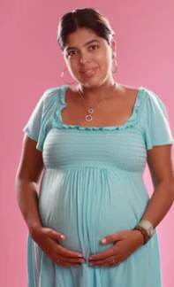
Case 2: Maria
Maria, age 28, G3P2, arrives to the prenatal clinic for the first time today
She thinks she is 8 months pregnant. Had some prenatal care in Nicaragua
She reports fleeing from Nicaragua 3 months ago with her brother because of her husband’s violence and he kicked her out of the house.
Her family told her she had to stay with him since it was her idea to marry him.
She has no records from this pregnancy.
She reports having cesarean deliveries for both children. Unknown uterine incisions.
Her other children are in Nicaragua, a daughter, age 10, and a son, age 4, who are staying with Maria’s mother.
Ethnicity: Mestizo Nicaraguan Primary language: Spanish
Stock photo
Notes:
Nancy

Slide 41
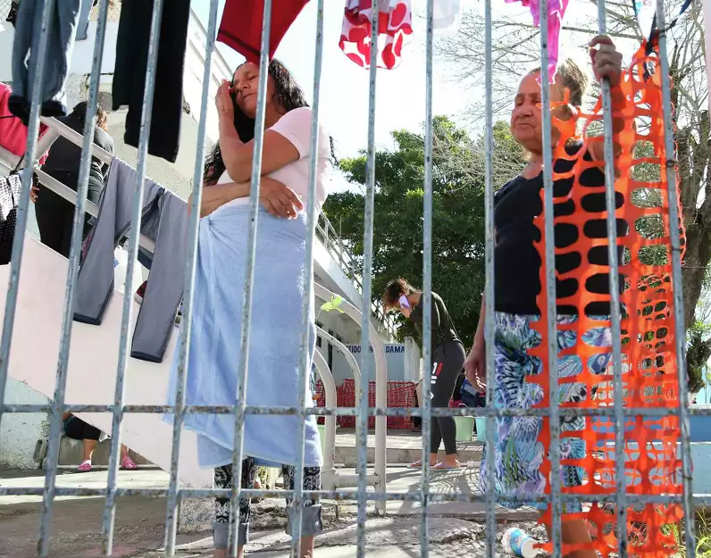
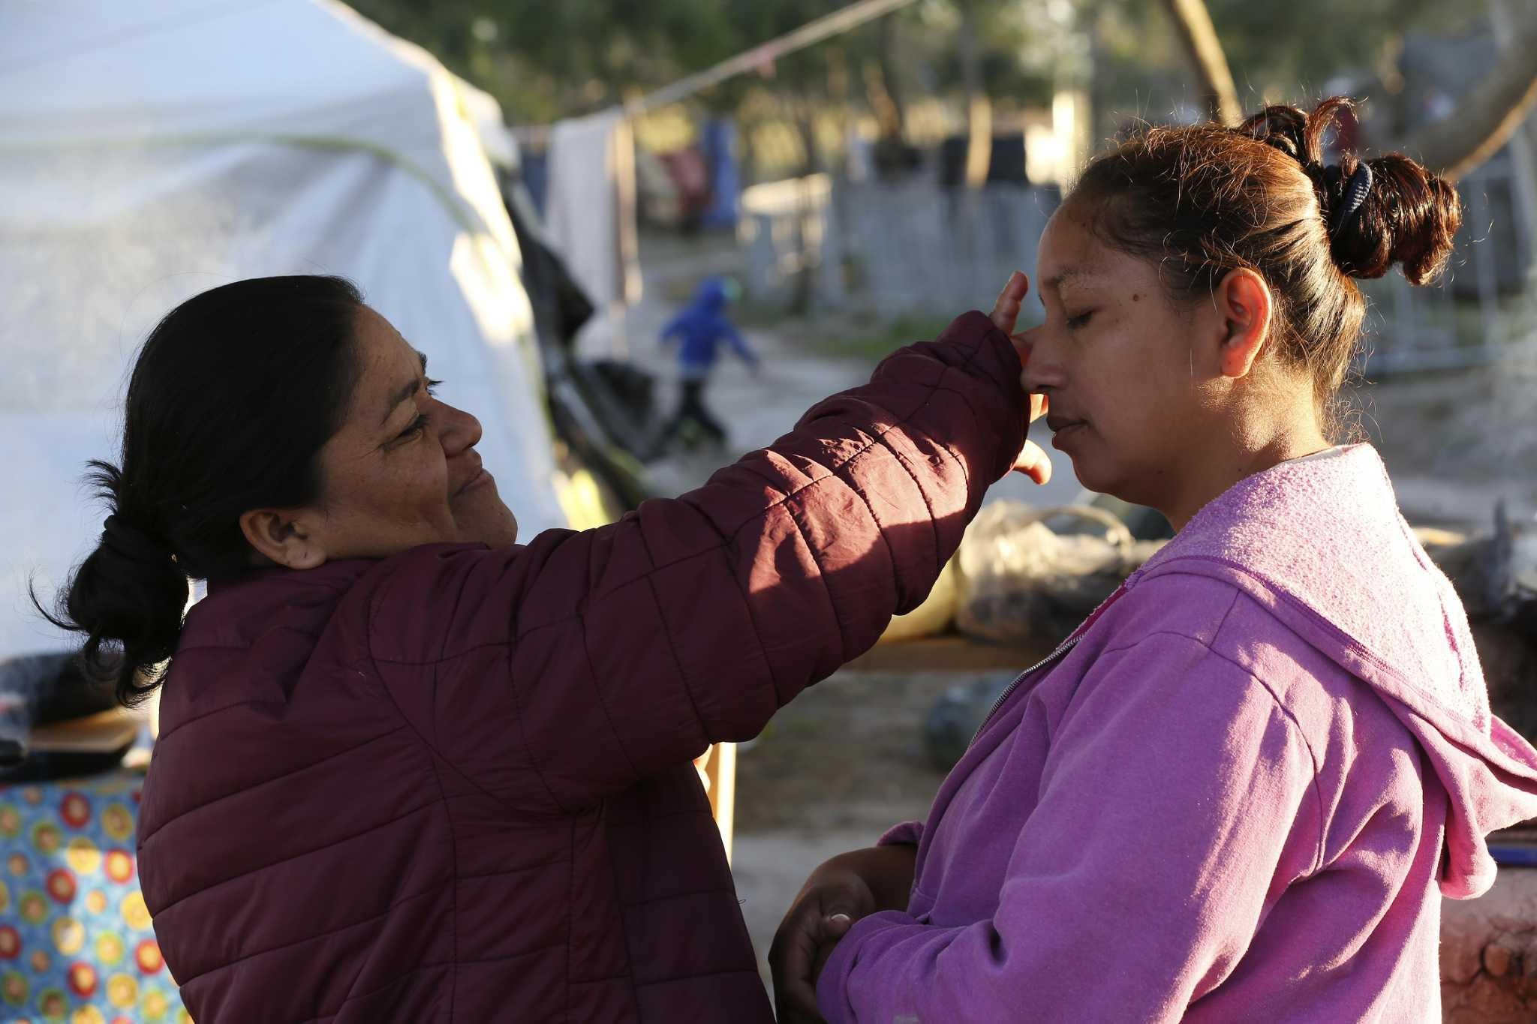
What are the Social Determinants of Health affecting Maria?
Language barrier
Health literacy; only attended primary school
Mistrust of the system
Social workers at the border refugee camp failed in the past
No family locally
Lack of medical benefits
Limited funds, no job
Transportation challenges for medical care
Late to care
Potential PTSD or other mental health challenges
Depression/guilt/shame related to leaving other children behind

Slide 42
LOCAL Advocacy by Nurses
Diverse refugee populations require nurses to adopt new approaches to best care for these communities
Providing respectful care
Onboarding training, annual & ongoing competencies
Evaluate & address structural factors in your workplace that perpetuate bias, discrimination for immigrants
Should be encouraged by facility leadership, care team & local community
Working with refugee families can present unique learning opportunities for nurses
Improving quality of care and reducing disparities
Photo: Comello, N. Sumpango, 2018. used with permission
Notes:
Diverse refugee populations require nurses to adopt new approaches to best care for these communities
Providing respectful care
Onboarding training, annual & ongoing competencies Should be encouraged by facility/entity leadership, care team & the local community
Should include specific cultures unique to area and any trends noted
CEUs should be offered as an incentive for licensed care givers to participate
A crucial way to build cultural humility into a healthcare system is with representation. A diverse workforce is essential
Leadership should model and participate in such trainings in person
Working with refugee families can present unique opportunities
To improve quality of care
Reduce disparities that may impact not only the woman, pregnancy and our own communities.
Evaluate, challenge, and address structural and practice-level factors that perpetuate explicit bias, discrimination, and inequalities for immigrants and other vulnerable populations.

Slide 43


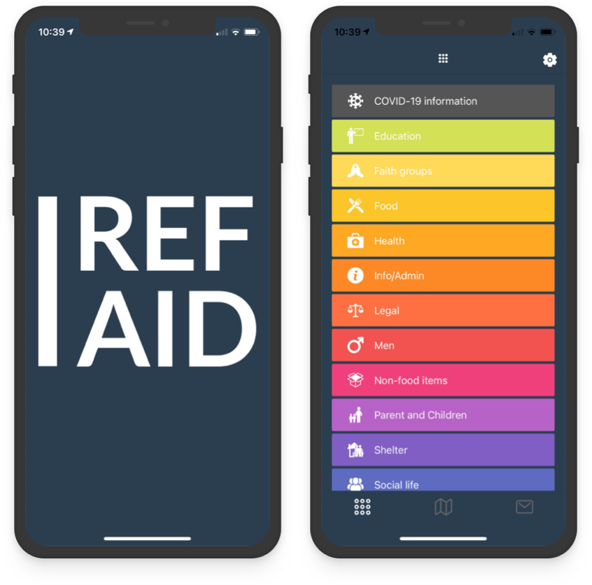

Resources for Families
Refugee Council USA
American Red Cross
RefAid Mobile App
Notes:
Refugee Council USA coalition of 41 US-based non-profit organizations supporting and protecting the rights of forcibly displaced people
American Red Cross helps migrants with basic aid during domestic disasters, reconnecting families separated by international emergencies, and responding to requests for services from government authorities and other nonprofits
The RefAid mobile app shows migrants, refugees and those who help them where services are near them
https://vimeo.com/555224265

Slide 44

Resource for Health Care Providers
Stress & Trauma Toolkit for Treating Undocumented Immigrants in a Changing Political and Social Environment
https://www.psychiatry.org/psychiatrists/diversity/education/stress-and-trauma/undocumented-immigrants

Slide 45
Other Resources for Families
Know Your Rights flyers & red cards
https://www.ilrc.org/red-cards
Legal services referrals
https://immigrationlawhelp.org
Anti-fraud brochures
https://www.ilrc.org/anti-fraud-flyers
Family preparedness toolkits
https://ilrc.org/family-preparedness-plan
Immigration options flyers
https://www.ilrc.org/immigration-options=undocumented-immigrant-children
2024 AWHONN

Slide 46
What about GLOBAL Nursing Involvement?
Nurses represent approximately 50% of the worldwide healthcare workforce- the primary link between communities and health system
Nurses can address challenges that transcend national borders:
Epidemic and pandemic response
Nurses are often the first to detect emerging infectious outbreaks and are the primary implementers of vaccination and prevention programs
Achieving global goals
The United Nations Sustainable Development Goals (SDGs), specifically those for health, gender equality and economic growth – cannot be reached without a strong, globally-connected nursing workforce
Addressing the nursing shortage
International collaboration is necessary for ethical recruitment and sustainable workforce development
Policy and leadership
Nurses bring a “front-line” perspective to high-level meetings at the World Health Organization(WHO) and the United Nations, explaining how high-level policies will realistically function in diverse cultural or religious contexts
Health equity
Global involvement helps nurses identify and change systemic inequalities, ensuring that underserved populations receive high-quality, culturally safe care
Notes:
Epidemic and pandemic response
Nurses are often the first to detect emerging infectious outbreaks and are the primary implementers of vaccination and prevention programs
Achieving global goals
The United Nations Sustainable Development Goals (SDGs), specifically those for health, gender equality and economic growth – cannot be reaches without a strong, globally-connected nursing workforce
Addressing the nursing shortage
International collaboration is necessary for ethical recruitment and sustainable workforce development
Policy and leadership
Nurses bring a “front-line” perspective to high-level meetings at the World Health Organization(WHO) and the United Nations, explaining how high-level policies will realistically function in diverse cultural or religious contexts
Health equity
Global involvement helps nurses identify and change systemic inequalities, ensuring that underserved populations receive high-quality culturally safe care

Slide 47
Benefits for Individual Nurses Enhances a nurse’s local practice
Able to provide cultural safety for various communities
Working with diverse populations improves a nurse’s ability to care for increasingly multicultural groups at home
Innovative problem-solving
Exposure to different health systems educates nurses and enhances their creativity and resourcefulness, especially in low-resource areas
Leadership development
Thinking globally improves a nurse’s perspective, resulting in more effective leadership and research skills, and policy advocacy

Slide 48
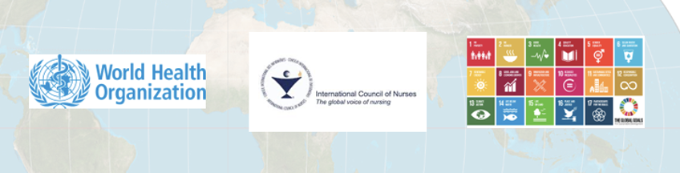
Where is Nursing?
Seriously UNDERREPRESENTED
Nurses are needed
The Wealth of a Nation is its People and Health
“…bold and transformative steps are urgently needed to shift
the world onto a sustainable and resilient path. “
United Nations Department of Economic and Social Affairs (n.d.). P 1.
Notes:
bold and transformative steps which are urgently needed to shift the world onto a sustainable and resilient path.

Slide 49
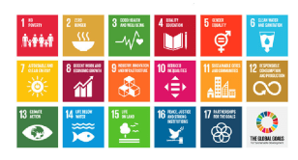
United Nations Sustainable Development Goals
(SDGs)
Sustainable Development GOALS: 2015-2030. https:sdgs.un.org/goals

Slide 50
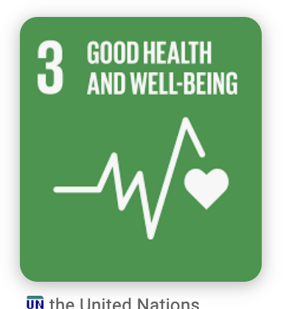
Sustainable Development Goal 3 “Ensure healthy lives and promote well-being for all at all ages” by 2030
Focus
Reducing maternal and child mortality
Ending major communicable diseases (AIDS, TB, Malaria)
Achieving universal health coverage
Reducing premature deaths from non-communicable diseases
https://globalgoals.org/goals/3-good-health-and-well-being/

Slide 51
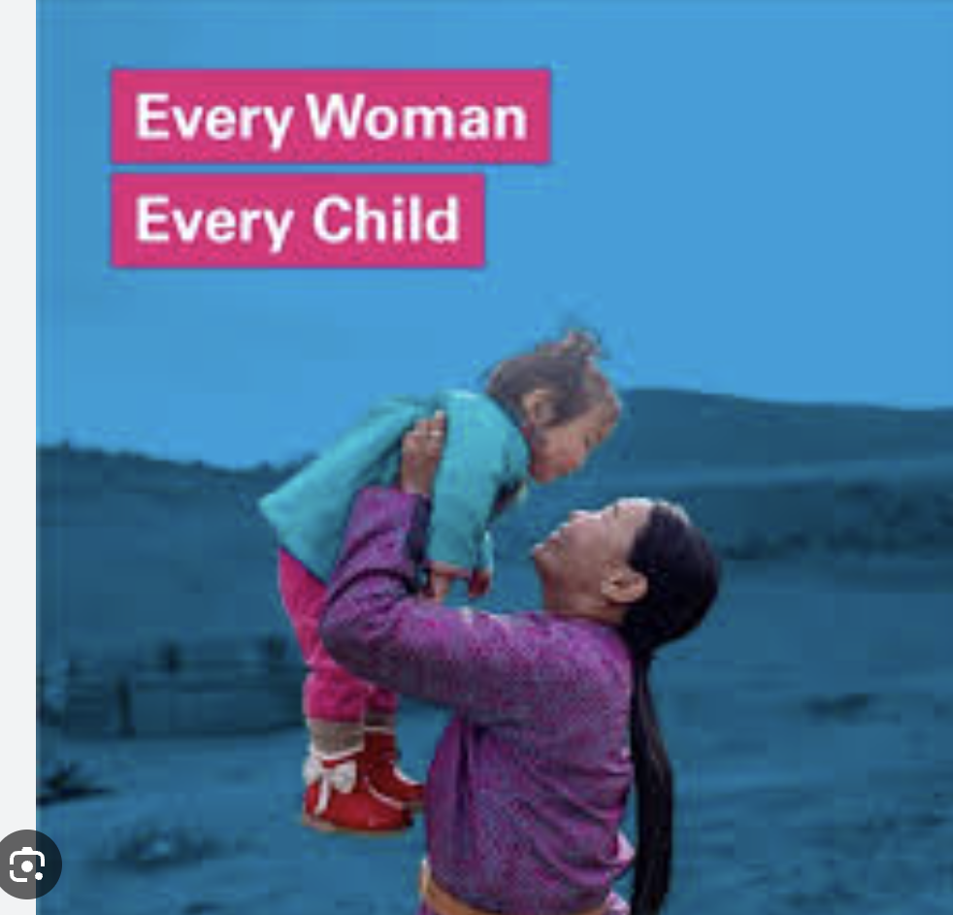
Every Woman, Every Child Global movement from United Nations in 2010
To address the health challenges facing women, children,
and adolescents worldwide
The global strategy: Survive – Thrive – Transform
SURVIVE End preventable deaths | THRIVE Ensure health & well-being | TRANSFORM
Decrease maternal mortality to 70 per 100,000 live births | End malnutrition | Eradicate extreme poverty Good quality secondary education
Decrease newborn mortality to 12/1000 births | Universal access to sexual & reproductive services | Achieve access to safe & affordable drinking water & equitable sanitation & hygiene
End pandemics | Quality childhood development | Enhance scientific research/encourage innovation
Decrease premature mortality | Decrease pollution-related deaths | Provide legal identity Enhance global partnership
https://www.who.int/publications/b/search?term=very+Woman+Every+Child+Global+Strategy+for+Women%E2%80%99s%2C+Children%E2%80%99s+and+Adolescents%E2%80%99+Health+%282016%E2%80%932030%29&language=eng

Slide 52
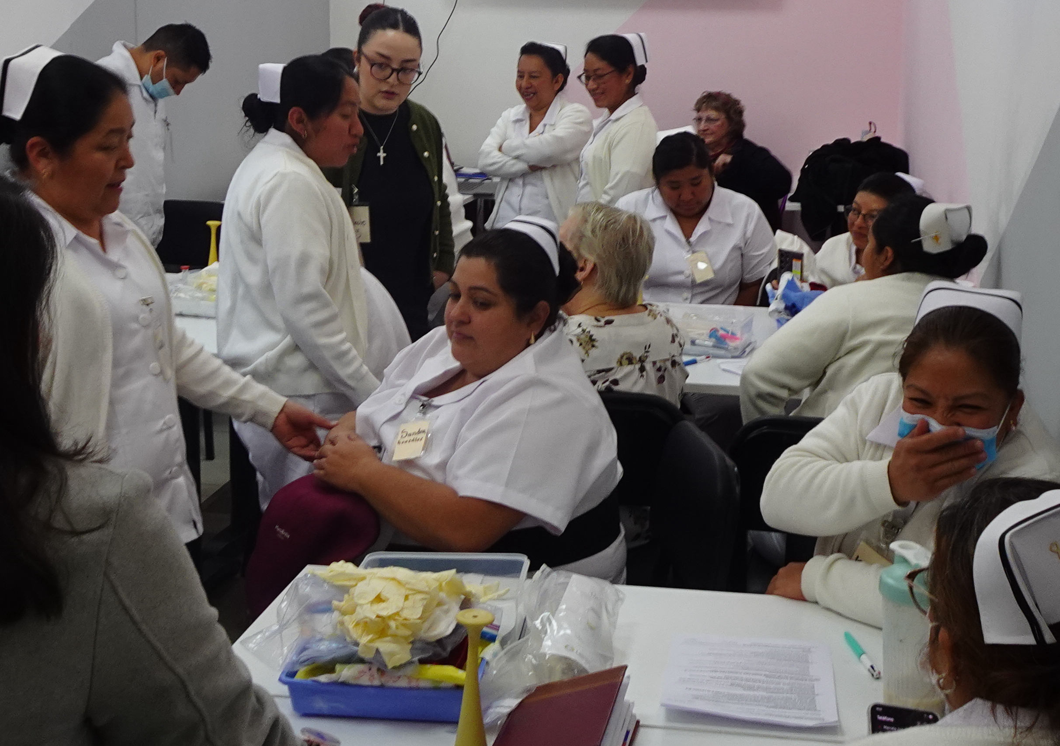
A New Story for Nursing
Think globally – Act locally
Cultivate a worldview
Learn the global agenda
Get involved with AWHONN Global
Fig.1 Nurse training Quetzaltenango, Guatemala, 2026. Used by permission.
“You have to take ownership and leadership of tomorrow.
For that to be possible, you have to strengthen your capacity
And widen your vision as a global citizen….”
General Ban Ki-moon, United Nations Secretary

Slide 53
AWHONN Global Health Leadership
New in 2025 [Global health strategy not yet Board approved]
Focus:
Building sustainable, bidirectional partnerships
Empowering nurses and midwives through education, research, and capacity building
Priority:
Long-term collaboration, shared learning, and development of global competencies among nurses and other healthcare professionals
2025 Global Health Initiatives Advisory Panel

Slide 54
Why is AWHONN adding a Global Health Focus?
Began in 2009; revived due to
Changing landscape of healthcare
Workforce shortages and migrations
Effects of global pandemics
Changing trends in health industries
Not equated with medical missions
Globalization forces have affected the expectations and responsibilities of professional organizations
For AWHONN, it’s a crucial step to maintain relevance, influence, and impact in an increasingly interdependent world.
By adopting a global perspective, AWHONN is able to:
Create meaningful partnerships
Strengthen research capacity
Develop sustainable networks that empower nurses and midwives to address complex global challenges
2025 Global Health Initiatives Advisory Panel

Slide 55
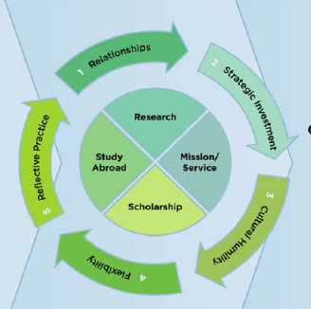
A Model for Upscaling Global Nursing and
Midwifery Partnerships
Foundational
Requisites
Upscaling Global
Capacity
Organizational Mission,
Vision & Values
Intellectual Capital
Servant Leadership
Funding
Professional Support
Advancing Global Health
Developing Nursing & Midwifery
Leaders.
Improving Nursing & Midwifery
Profession & Practice
Uplifting Nursing & Midwifery Profession
Expanding Nursing & Midwifery Practice
Spies et al,2017
Notes:
This best-practice model provides a structured approach to enhance international collaboration and capacity building, in nursing and midwifery professions.
Focusses on several foundational requisites clear mission, vision, and values, knowledge sharing, servant leadership, secured funding, and professional support from /global nursing organizations. Each section ensures that partnerships in initiatives are meaningful, sustainable, and respectful of cultural differences.
CORE Activities include collaborative research, study abroad programs, mission and service projects, and teaching or scholarship exchanges, All of this contributes to the advancement of nsg and midwifery capabilities on a global level.

Slide 56
Objectives
Core Activities
Leader development
Encouragement of policy changes
Promotion of public health by upscaling education and training for nurses and midwives worldwide
Collaborative research
Study abroad programs
Mission and service projects
Respectful engagement with local communities
Learning from local providers
Partnering with local leaders & organizations
Sharing skills & knowledge
Teaching or scholarship exchanges
2025 Global Health Initiatives Advisory Panel
Notes:
Each section ensures that partnerships in initiatives are meaningful, sustainable, and respectful of cultural differences.
CORE Activities include collaborative research, study abroad programs, mission and service projects, and teaching or scholarship exchanges, All of this contributes to the advancement of nsg and midwifery capabilities on a global level.

Slide 57
AWHONN: Our Window of Opportunity
“Nurses, midwives, maternal community workers . . .
Step up to the table and be the VOICE
for the countless women and children,
in the poorest regions,
whose voices are not heard and
who bear the highest burden of mortality.”
Brown, S.(2020). Health Policy and Advocacy: Maternal and Infant Global Health:
Broadening our Vision retrieved from www.who.int/pmnch/activities/advocacy/global/en/.​

Slide 58
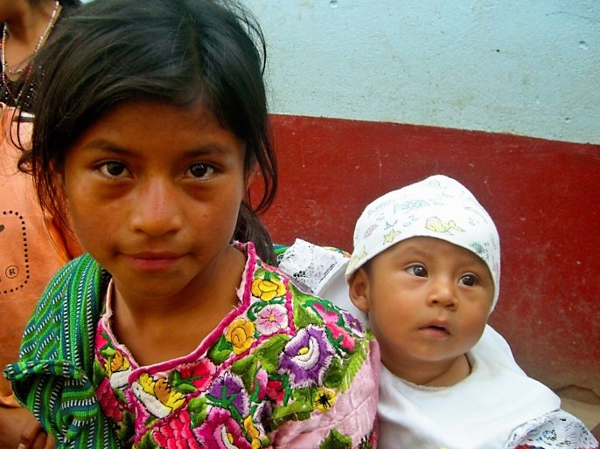
This is Why…
WE GO
WE
SERVE
WE
TEACH
WE DISSEMINATE
Girl carrying sibling, N.Comello, Sumpango, Guatemala, 2013
Notes:
Fig 1: Description, Creator, Source")

Slide 59
References
Advocacy for Global Health Partnership (n.d.). Brocher Declaration. https://www.ghpartnerships.org/brocher
American Psychiatric Association (n.d.). Stress & trauma toolkit. https://www.psychiatry.org/psychiatrists/diversity/education/stress-and-trauma/undocumented-immigrants
American College of Obstetricians and Gynecologists (2023). Health care for immigrants – Committee on health care for underserved women. Obstetrics & Gynecology, 141(2), 427-433.
American Nurses Association (ANA) (n.d.). Scope of practice. https://www.nursingworld.org/practice- policy/scope-of practice /#: ~:text =What %3A%20 Nursing %20is%20the%20 protection, groups%2C%20communities %2C%20and%20populations.
ANA (2010a). Healthcare for undocumented immigrants (Resolution from 2010 House of Delegates). ANA Issue Brief. https://www.nursingworld.org/~4af0ba/globalassets/docs/ana/ethics/nursing-without-borders-access-to- carefor-immigrants.pdf
ANA (2010b). Nursing: Scope and standard of practices (2nd ed.) Silver Spring: Author.
ANA (2015). Code of ethics for Nurses with interpretive statements. https://www.nursingworld.org/practice- policy/nursing-excellence/ethics/code-of-ethics-for-nurses/
Batalova, J. B. J. (2024, March 13). Frequently requested statistics on immigrants and immigration in the United States.. https://www.migrationpolicy.org/article/frequently-requested-statistics-immigrants-and-immigration-united- states
Behboudi-Gandevani, S., Bidhendi-Yarandi, R., Panahi, M.H., Mardani, A., Kymre, I.G., Paal, P. & Vaismoradi, M. (2022). A Systematic Review and Meta-Analysis of the Risk of Stillbirth, Perinatal and Neonatal Mortality in Immigrant Women. International Journal of Public Health, 67 (Article 1604479), 1-13.

Slide 60
References
Bhasin, A. (2021). A systemic failure – Immigrant moms and babies are being denied health care. National Partnership for Women & Families https://nationalpartnership.org/report/immigrant-moms-and-babies- denied/
World Health Organization [WHO] (n.d.). Refugee and migrant health. https://www.who.int/health- topics/refugee-and-migrant-health#tab=tab_1
World Health Report (2022). Progress report on Every Woman Every Child, Global strategy for women’s, children's and adolescents. (2016-2030). https://protect.everywomaneverychild.org/
Biggerstaff, M.E. & Skomra, T.S. (2020). Nurses as Immigrant Advocates: A Brief Overview. The Online Journal of Issues in Nursing, 25(2), https://doi.org/10.3912/OJIN.Vol25No02PPT69.
Bhasin, A. (2021). A systemic failure – Immigrant moms and babies are being denied health care. National Partnership for Women & Families https://nationalpartnership.org/report/immigrant-moms-and-babies- denied/
Brown, S. (2020). Health policy and advocacy: Maternal and Infant Global Health: Broadening our vision. Retrieved from www.who.int/pmnch/activities/advocacy/global/en.
Centers for Disease Control [CDC] (2022). Refugee and immigrant health. https://www.cdc.gov/immigrantrefugeehealth/about-irmh.html
Curtis, E., Jones, R., Tipene-Leach, D., Walker, C., Loring, B., Paine, S.-J.,& Reid, P. (2019). Why cultural safety rather than cultural competency is required to achieve health equity: A literature review and recommended definition. International Journal for Equity in Health. 18: 174. https://doi.org/10.1186/s12939-019-1082-3.

Slide 61
References
Duckles, A.B., Caplow, J., & Barden-Maja, A. (2018). The medical evaluation of the newly resettled female refugee: A narrative review. Journal of Refugee and Global Health, 1(2), 24-31.
Eggers, E.E., Ibrahim, .B., Nyhan, K., Desibhatla, M., Gleeson, D., & Hagaman, A. (2024). Patient-defined cultural safety in perinatal interventions: A qualitative scoping review. Health Equity, 8.1, DOI: 10.1089/heq.2023.0152
Gibson, I. (2022). Annual Flow Report FY 2022- Office of Immigration Statistics - Refugees and Asylees. https://www.dhs.gov/ohss/topics/immigration/refugees-asylees-afr
Immigrant Legal Resource Center (n.d.). Help for immigrant families: Guidance for schools. https://www.ilrc.org/sites/default/files/resources/school_resource_v3.pdf
Kaiser Family Foundation (n.d.). The independent source for health policy research, polling, and news. kff.org
Lekas HM, Pahl K, Fuller Lewis C. Rethinking Cultural Competence: Shifting to Cultural Humility. Health Serv Insights. 2020 Dec 20;13:1178632920970580. doi: 10.1177/1178632920970580. PMID: 33424230; PMCID: PMC7756036
LoGiudice, J.A., Tillman, S., & Sarguru, S.S. (2023). A midwifery perspective on trauma-informed care clinical recommendations. Journal of Midwifery & Women’s Health, 68(2), 165-169.
Menscher, C., & Maul, A. (2016). Key ingredients for successful trauma-informed care implementation. Center for Health Care Strategies. https://www.samhsa.gov/sites/default/files/programs_campaigns/childrens_mental_health/atc-whitepaper- 040616.pdf
Mcgee-Avila, L. (2018, June 21). Practicing cultural humility to transform health care. Robert Wood Johnson Foundation: Culture of Health Blog. https://www.rwjf.org/en/blog/2018/06/practicing-cultural-humility-to- transform-healthcare.html
.
Notes:
Protect the promise: equal access and opportunity for every woman, child and adolescent. 2022 progress report on the Every Woman Every Kurth, A.E. (2021). Child Global Strategy for Women’s, Children’s and Adolescents’ Health (2016–2030)

Slide 62
References
Pere, M.C., Fortuna, L. (2005). Psychosocial stressors, psychiatric diagnoses and utilization of mental health services among undocumented immigrant Latinos. Journal of Immigrant & Refugee Services, 3(1-2): 107- 123.
Phillai, D., Artiga, S., Hamel, L., Schumacher, S., Kirzinger, A….Kearney, A. (2023). Health and health care experiences of immigrants: The 2023 KFF/LA Times survey of immigrants. Published Sept 17, 2023.
Rasori, A. (2019). The Role of Nurses in Humanitarian Medicine: Three educational strategies for sustainable short term medical volunteer trips. International Journal of Nursing, 6(1), 135-140.
Rayment-Jones, H., Mohamud, Y., Lovell, H., Rankin, J., Sandall, J., Peeren, S., Dube, M., Hecktor-Jaack, N.-S., Barry, Z., Turienzo, C.F., Sowah, E., Stacey, T., Castaner, M., Aquino, M.R.J., Jolly, A., Broadhead, J., Haith- Cooper, M., Easter, A., & Burton, S. (2026). Maternal and early childhood health and social impacts of migrants in high-income countries and the impact of policies that restrict access to healthcare; a systematic review and meta-analysis. Journal of Migration and Health, Vol. 13, 100391 Rosa, W.E., Catton, H., Davidson, P.M., Hannaway, C.J., Iro, E., Klopper, H.C., Madigan, E.A., McConville, F.E., Stilwell, B.,& Kurth. A.E. (2021). Nurses and midwives as global partners to achieve the sustainable development goals in the Anthropocene. Journal of Nursing Scholarship, 53(5), 552-560, doi: 10.1111/jnu.12672.
Salvage, J., & White, J. (2020). Our future is global: Nursing leadership and global health. Rev. Latino-Am. Enfermagem. 28: 3339. DOI: http:/doi.org/10.1590/1518-8345.4542.3339.
Shahin Kassam, S., Butcher, D., & Marcellus, L. (2022). Experiences of nurses caring for involuntary migrant maternal women: A qualitative systematic review. JBI Evidence Synthesis. DOI: 10.11124/JBIES-21-00181.
Spies, L.A., Garner, S.L., Faucher, M.A., Hastings-Tolsma, C., Riley, I., Millenbruch, L., Prater, Conroy, S.F. (2017). International Nursing Review, 64(3), p. 338

Slide 63
References
Starobin, A. (2022). Failures of US health care system for pregnant asylum seekers: A migrant clinicians network white paper. https://www.migrantclinician.org/blog/2022/oct/mcn-white-paper-pregnant-asylum- seekersstruggleaccessprenatalcare.html#:~:text=Today%2C%20Migrant%20Clinicians%20Network%20r eleased,prenatal%20care%2C%20despite%20their%2legal
Tervalon & Murray-Garcia. (1998). Cultural humility versus cultural competence: A critical distinction in defining physician training outcomes in multicultural education. Journal of Healthcare for the Poor and Underserved, 9(2), 117-125.United Nations (1998). Recommandations on Statistics of International Migration. https://unstats.un.org/unsd/publication/seriesm/seriesm_58rev1e.pdf
United Nations Higher Commission for Refugees (The UN Refugee Agency) (n.d.). UNHCR Projected 2018 Global Resettlement Needs. Geneva: 23rd Annual Tripartite Consultations on Resettlement. https://www.unhcr.org/us/
United Nations Common Agenda (n.d.). Sustainable Development Goals (SDGs).
United Nations Department of Economic and Social Affairs (n.d.). Preamble p 1. https://sdgs.un.org/2030agenda
U.S. Census Bureau. (2019). Quick facts. https://www.census.gov/quickfacts/fact/table/US/PST045216
U.S. Department of Health and Human Services. (2019). Think cultural health education: Combating implicit bias and stereotypes. https://thinkculturalhealth.hhs.gov

Slide 64
References
Winn, A., Hetherington, E. & Tough, S. (2018). Caring for pregnant refugee women in a turbulent policy landscape: perspectives of health care professionals in Calgary, Alberta. Int J Equity Health, 17, 91. https://doi.org/10.1186/s12939-018-0801-5
World Health Organization [WHO] (n.d.). Refugee and migrant health. https://www.who.int/health- topics/refugee-and-migrant-health#tab=tab_1
World Health Report (2022). Progress report on Every Woman Every Child, Global strategy for women’s, children's and adolescents. (2016-2030). https://protect.everywomaneverychild.org/

Slide 65

Contact
Information
Nancy Huhta Comello
safebirthguatemala@gmail.com
Notes:
Hvala. SERBIAN
Obrigado. PORTUGUESE
Ramet. CATALAN
Grazie. ITALIAN I
Kiitos. FINNISH
Danke. GERMAN
Shukraan. SOMALI
Merci. FRENCH
Takk. NORWEGIAN
Chacnbo SCOTTISH
Barka. HAUSA
Arigato. ESTONIAN
Gracias. SPANISH
Euxapiotw. GREEK
Danke je. DUTCH
Tak. INDONESIA

